Slide 1
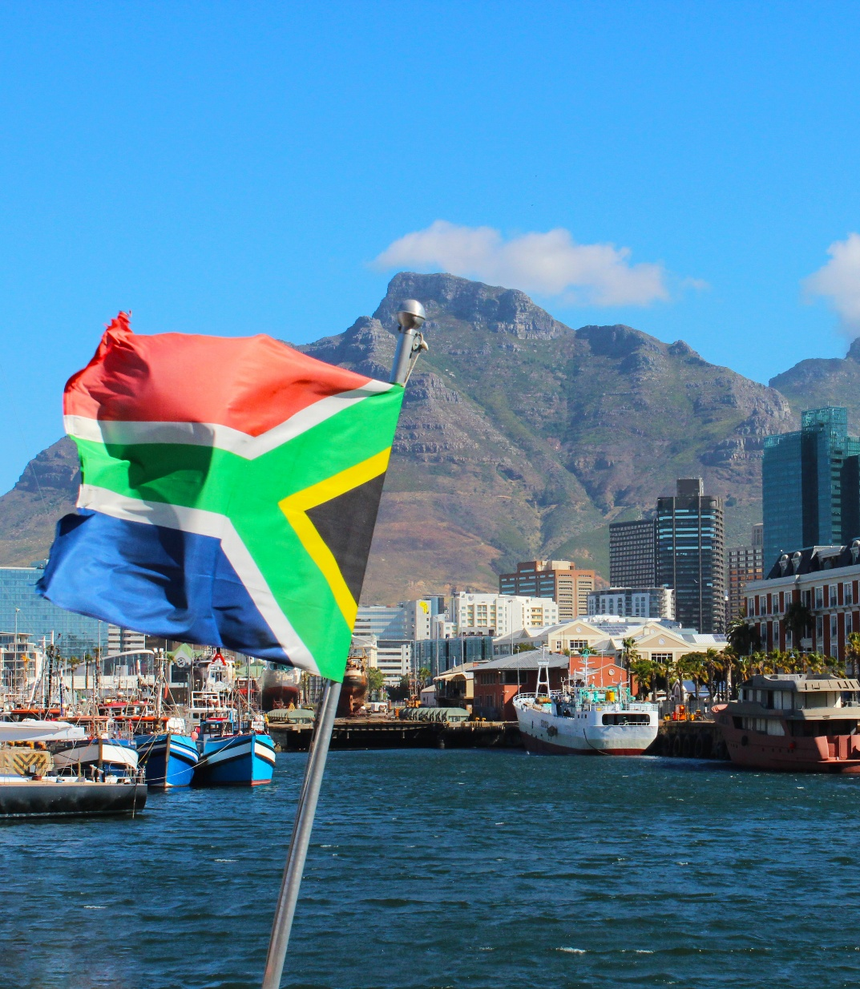
Mobilizing Capital for South Africa’s Transport Sector
From Projects to Investable Assets
South Africa
March 2026
https://treasury.worldbank.org/en/about/unit/treasury/ibrd-financial-products

Slide 2
Agenda
Introduction: The Core Challenge
PIPELINE: Credible, Investable Projects
PRODUCT: Match Capital to the Right Instruments
PROTECTION: Risk-Sharing
What Needs to Change
How Multilaterals Can Help
Key Takeaways

Slide 3
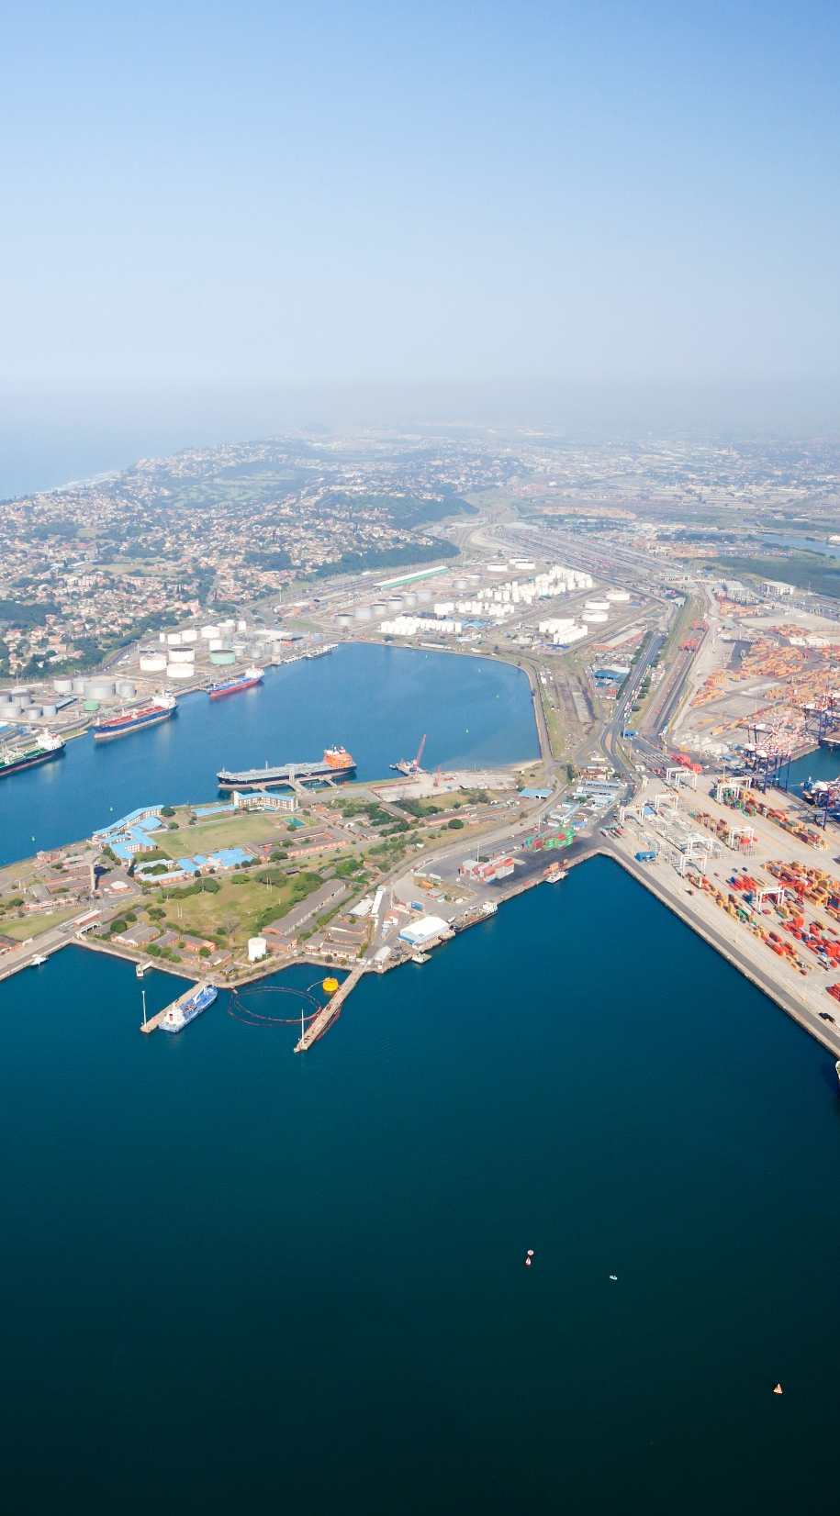

Introduction The Core Challenge
South Africa does not lack capital
— it lacks bankable, de-risked, investable transport opportunities at scale.
Deep domestic savings and sophisticated markets exist.
Investment is constrained by risk, pipeline quality, and transaction structures.
The opportunity: convert transport reforms and projects into investable assets.
Notes:
Introduction / Opening remarks
Core message: South Africa doesn’t lack capital — it lacks bankable, de-risked, investable transport opportunities packaged at scale.
“South Africa has deep pools of long-term domestic savings and sophisticated financial markets, but infrastructure allocations remain constrained by risk, pipeline quality, and the structure of transactions. The prize is to convert transport reforms and projects into investable assets.”
OR…… “South Africa possesses substantial capital but requires bankable, de-risked transport projects to attract investment, which can be achieved by developing a credible pipeline, matching funding sources with appropriate investment products, and employing risk-sharing mechanisms supported by multilateral institutions to enhance project bankability, governance, and financing structures, thereby enabling long-term capital inflows and addressing the transport sector’s financing gap”

Slide 4
Creating Investable Assets
Pipeline
Product
Protection
Notes:
How do we create investable assets: “Pipeline–Product–Protection.”
Pipeline – Product – Protection
A practical framework to align reforms, capital, and risk-sharing.
(Emphasize: the conference is intended to serve as a platform to “crowd source ideas” and align on reforms and the pipeline)

Slide 5
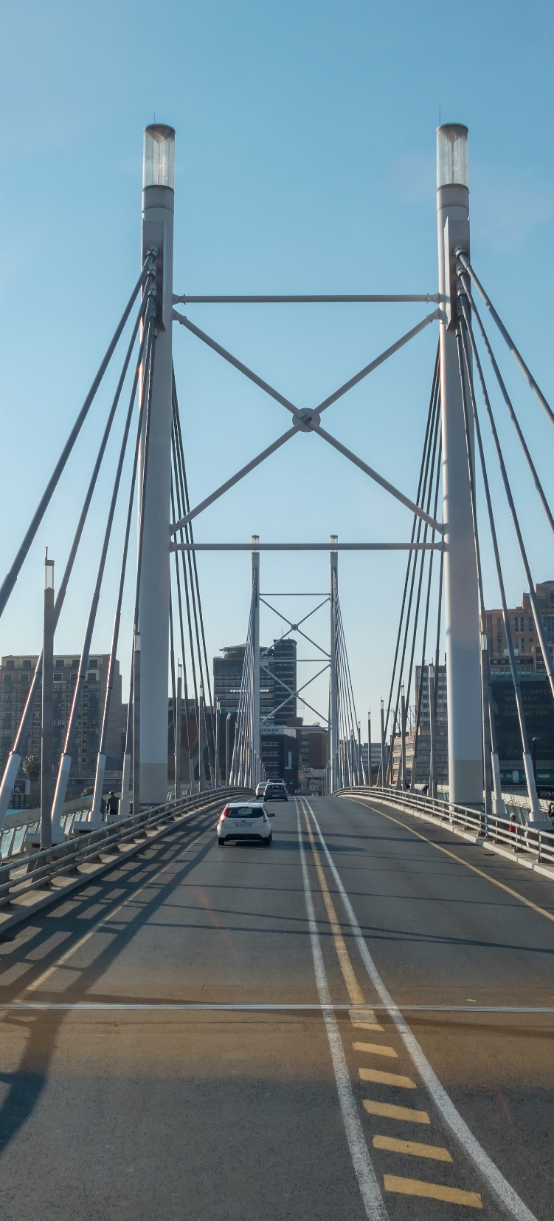
PIPELINE
Pipeline
Credible, Investable Transport Projects
Investors buy predictable cash flows, governance, and credible counterparties.
Realistic demand and revenue assumptions or availability-payment models.
Robust procurement and contract management.
Clear tariffs and enforceable regulatory regimes.
Notes:
. PIPELINE: Create a credible, investable transport pipeline
Investors don’t buy “projects”; they buy predictable cashflows + clear governance + credible counterparties.
Transport investment readiness hinges on:
realistic demand/revenue assumptions (or transparent availability-payment structures),
robust procurement and contract management,
clear tariff/fee frameworks (where user-pay is used),
and enforceable performance/regulatory regimes.
(Emphasize: “This Conference is an excellent platform for all of us to crowd-source ideas, define reforms needed, and prioritize project pipelines.”

Slide 6
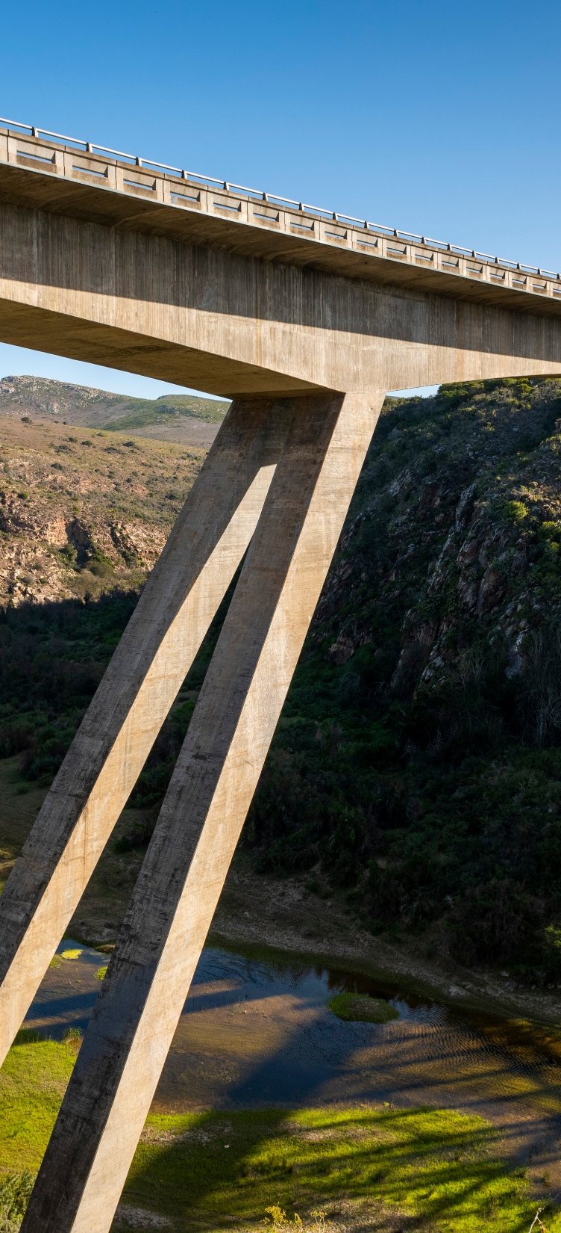
PRODUCT
Product
Match Capital to the Right Transport Investments
Different pools of capital have different objectives and constraints.
The task is to structure transport sector investments into suitable products.
Institutional Investors
Pension Funds
Sovereign Wealth Funds & Public Pools
Infrastructure Funds
What they want: scale, liquidity, predictable cashflows, disclosure.
Project and infrastructure bonds, including thematic formats.
Listed infrastructure vehicles and yield platforms.
Diversified infrastructure debt funds.
Standardization enables capital-market scale.
Long-duration assets aligned with liabilities.
Operate under strict prudential limits.
Investment-grade infrastructure debt with guarantees.
Pooled vehicles with strong governance.
Phased approach: debt first, equity later.
Long-term, state-linked capital anchoring transactions.
Anchor investors in infrastructure funds.
Providers of catalytic or first-loss capital.
Co-investors to signal confidence and reduce political risk perception.
Seek stability, repeatability, and exits.
PPP equity combined with long-term debt.
Platform approaches across multiple assets.
Co-investment frameworks to reduce transaction costs.
Notes:
PRODUCT: Match funding sources to the right transport investment products
Let’s take a look at the different pools of capital, their constraints, and what needs to be done to create a pipeline of investable transport-sector products and projects to attract them.
1) Institutional investors (asset managers, insurers)
What they want: scale, liquidity, predictable cashflows, credible disclosure.
Products that work:
project bonds/infrastructure bonds (including thematic or sustainability-linked formats),
listed infrastructure vehicles and regulated yield platforms,
diversified infrastructure debt funds that reduce single-project concentration risk.
(Emphasizes standardization of sustainable finance frameworks and scaling capital-market transactions for infrastructure are crucial)
2) Pension funds
What they want: long-duration assets that match liabilities, but with strict prudential constraints.
Products that work:
investment-grade-style infrastructure debt enhanced with guarantees,
pooled vehicles with strong governance,
phased exposure: start with debt/guaranteed debt, then move up the risk curve to equity once performance is proven (this pattern is highlighted in internal institutional investor research).
3) Sovereign wealth funds (SWFs) & public long-term pools
Even if a country’s “SWF” is small or structured differently, what they want in principle is: long-term state-linked pools to anchor deals and crowd-in others.
Roles SWFs/public pools can play:
anchor investor in infrastructure funds,
provider of first-loss / catalytic capital (carefully priced and transparently governed),
co-investor alongside pensions to signal confidence and reduce perceived political risk.
4) Infrastructure funds (domestic and global)
What they want: a stable investment regime, repeatability, and credible exit pathways.
Products that work:
PPP equity + long-term debt with predictable risk allocation,
platform approaches (multiple assets under one governance/financing umbrella),
co-investment frameworks that reduce transaction costs for each deal.

Slide 7

PROTECTION
Protection
Risk-Sharing
Risk-sharing lowers financing costs and extends tenor.
Multilateral institutions play a central role.
Tools include lending, guarantees, and contingent credit lines.
Notes:
. PROTECTION: Use risk-sharing to unlock long-term capital at lower cost
This is where multilateral development institutions come in, and where the use of lending, contingent credit lines, guarantees, and investments becomes extremely relevant.

Slide 8
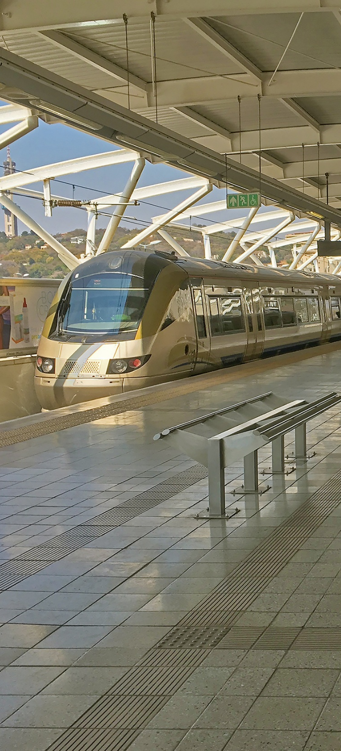
What Needs to Change
The enabling conditions investors will listen for
Project preparation at scale: standardized contracts, feasibility, land/permits, procurement readiness.
Credit quality uplift: reduce reliance on blanket sovereign guarantees by using targeted credit enhancement.
Clear PPP/legal frameworks: modernize rules and market infrastructure
Transparency and reporting: governance, disclosure, and pipeline visibility.
Local-currency and tenor solutions: investors need long tenor; instruments must support it.

Slide 9



How Multilaterals Can Help
1
2
3
Policy, public sector financing, and guarantees
Mobilization + private solutions + transaction advisory
Political risk insurance + credit enhancement to lower pricing

Slide 10
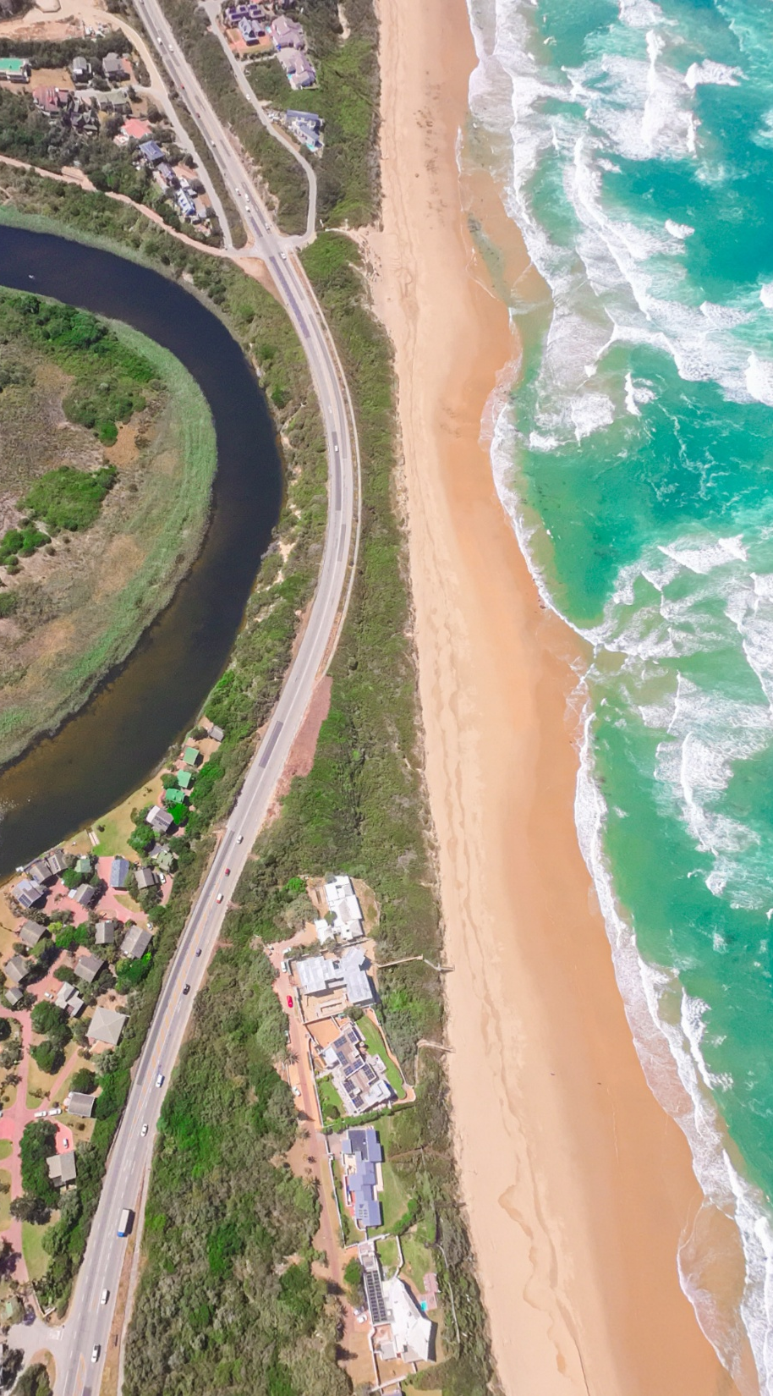
Policy Reform and public sector financing
1
(1) Policy & sector reform support
Help the government implement reforms that make projects bankable (procurement, SOE governance, tariff frameworks, freight logistics performance, etc.).
Convene government + regulators + investors to align the “rules of the game.”
(2) Public sector finance for strategic gaps, multilateral lending and contingent financing
Targeted lending for public goods (resilience, safety, maintenance backlogs, corridors) that private capital won’t fully fund.
Use multilateral funding and contingent credit lines for gaps and quasi credit enhancement, or project cash flow, or investment protection
Notes:
How can multilaterals help
A) Policy, public sector financing, and guarantees
(1) Policy & sector reform support
Help the government implement reforms that make projects bankable (procurement, SOE governance, tariff frameworks, freight logistics performance, etc.).
Convene government + regulators + investors to align the “rules of the game.”
(2) Public sector finance for strategic gaps, multilateral lending and contingent financing
Targeted lending for public goods (resilience, safety, maintenance backlogs, corridors) that private capital won’t fully fund.
Use multilateral funding and contingent credit lines for gaps and quasi credit enhancement, or project cash flow, or investment protection
(3) Credit enhancement / Guarantees to crowd in private capital
Help government and investors structure potential Partial Credit Guarantees and organize informal market sounding with banks and institutional investors to test appetite, tenor, coverage, triggers, and currency considerations — and to ensure alignment with prudential constraints.
(Emphasize: Guarantees don’t replace reforms; they accelerate them by converting future performance and policy credibility into investment-grade risk today.)

Slide 11
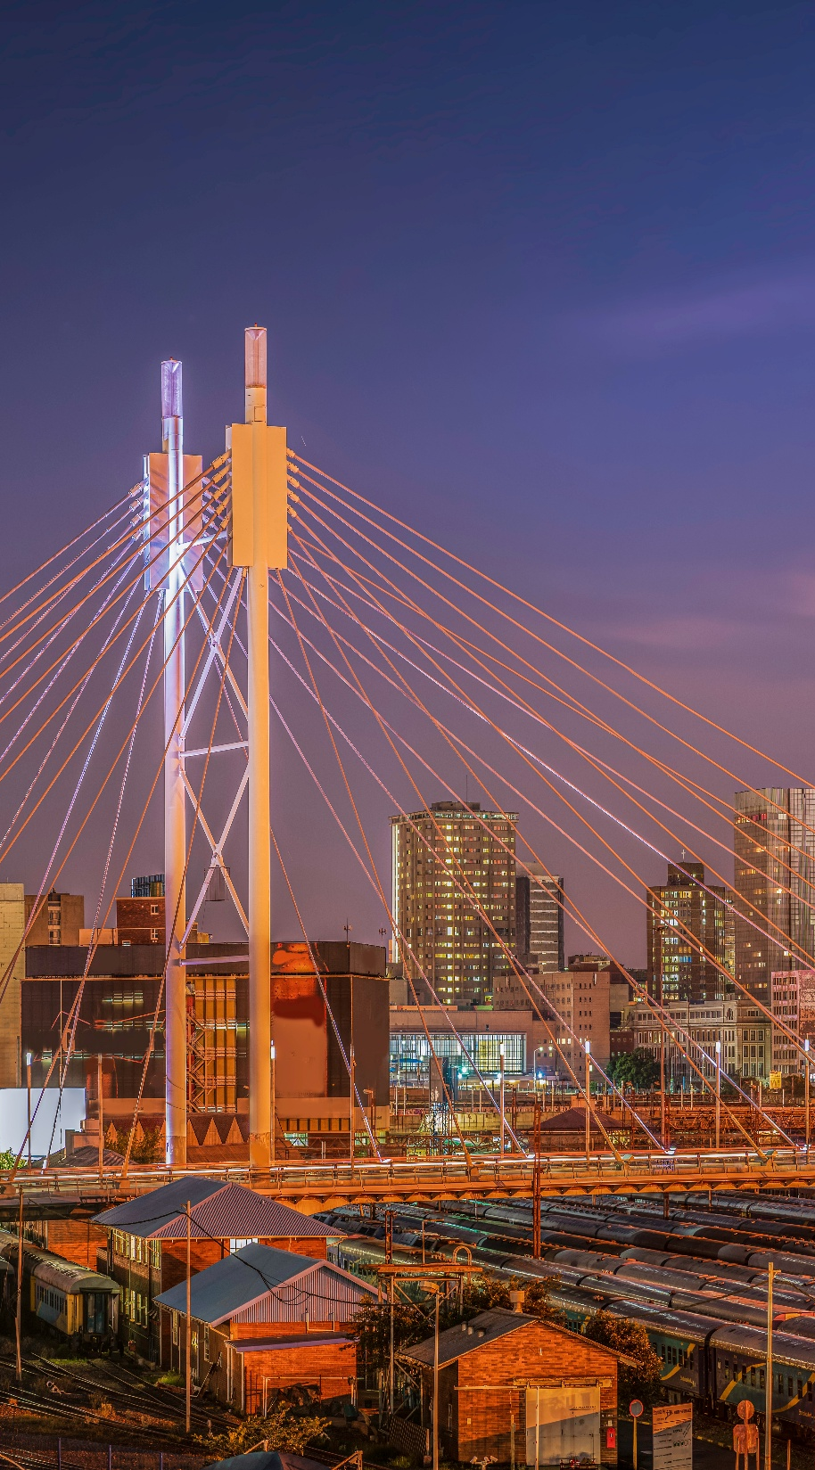
Mobilization + private solutions + transaction advisory
2
The private sector arm of multilateral development institutions can act as a bridge to the private market by
Investing in commercially viable projects and PPPs; supports structuring and bankability.
Mobilizing capital alongside (syndication and co-lending structures; speak generally if you’re not naming a specific program).
Helping develop capital market approaches
Notes:
How can multilaterals help
A) Policy, public sector financing, and guarantees
(1) Policy & sector reform support
Help the government implement reforms that make projects bankable (procurement, SOE governance, tariff frameworks, freight logistics performance, etc.).
Convene government + regulators + investors to align the “rules of the game.”
(2) Public sector finance for strategic gaps, multilateral lending and contingent financing
Targeted lending for public goods (resilience, safety, maintenance backlogs, corridors) that private capital won’t fully fund.
Use multilateral funding and contingent credit lines for gaps and quasi credit enhancement, or project cash flow, or investment protection
(3) Credit enhancement / Guarantees to crowd in private capital
Help government and investors structure potential Partial Credit Guarantees and organize informal market sounding with banks and institutional investors to test appetite, tenor, coverage, triggers, and currency considerations — and to ensure alignment with prudential constraints.
(Emphasize: Guarantees don’t replace reforms; they accelerate them by converting future performance and policy credibility into investment-grade risk today.)

Slide 12
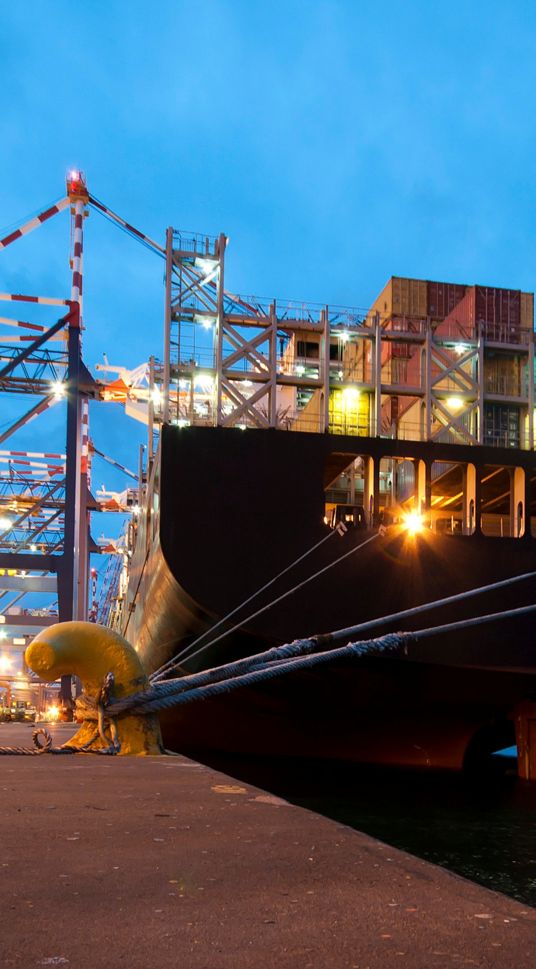
Political risk insurance + credit enhancement to lower pricing
3
The value proposition of the guarantees offered by multilateral development institutions is to de-risk “non-commercial” risks that constrain long-term investors.
The different guarantees that could be useful to de risk transport sector projects include:
Credit Guarantees
Political Risk Guarantees
Trade Finance Guarantees
These guarantees alone or combined could help turn perceived ‘country risk’ into a priced, insurable risk, which can expand the investor base and reduce spreads

Slide 13

Key Takeaways
Why this matters now: Funding for the development of the Transport Sector should match the scale of the needs in SA
The financing gap is a structuring gap: capital exists; the pipeline/products aren’t investable enough.
Attracting pools of capital in addition to Public and multilateral funding should come from institutional, pensions, SWFs/public pools, and infrastructure funds.
Enablers: pipeline, governance, regulatory clarity, disclosure, local currency/tenor, risk-sharing.
What multilaterals could offer
Assistance with Policy Reform, financing, and contingent credit lines
Private Capital Mobilization, transaction advisory, and capital markets development.
Political/project risk and credit enhancement guarantees to bring in long-term capital at better pricing

Slide 14

Contact Us
Miguel Navarro-Martin
Manager
Financial Products
World Bank Group Treasury
+1-202-458-4722
mnavarromartin@worldbank.org
https://treasury.worldbank.org/en/about/unit/treasury/ibrd-financial-products

Slide 15
Disclaimers
©2026 The International Bank for Reconstruction and Development / The World Bank
1818 H Street NW, Washington DC 20433 USA
Telephone: 202-473-1000
Internet: https://treasury.worldbank.org
All rights reserved.
This work is a product of the staff of the International Bank for Reconstruction and Development/The World Bank. The findings, interpretations, and conclusions expressed in this work do not necessarily reflect the views of the Executive Directors of the World Bank or the governments they represent.
The World Bank does not guarantee the accuracy of the data included in this work. The boundaries, colors, denominations, and other information shown on any map in this work do not imply any judgment on the part of the World Bank concerning the legal status of any territory or the endorsement or acceptance of such boundaries.
Rights and Permissions
The material in this publication is copyrighted. Copying and/or transmitting portions or all of this work without permission may be a violation of applicable law. The International Bank for Reconstruction and Development / The World Bank encourages dissemination of its work and will normally grant permission to reproduce portions of the work promptly.
For permission to photocopy or reprint any part of this work, please send a request to FP@worldbank.org

Slide 16
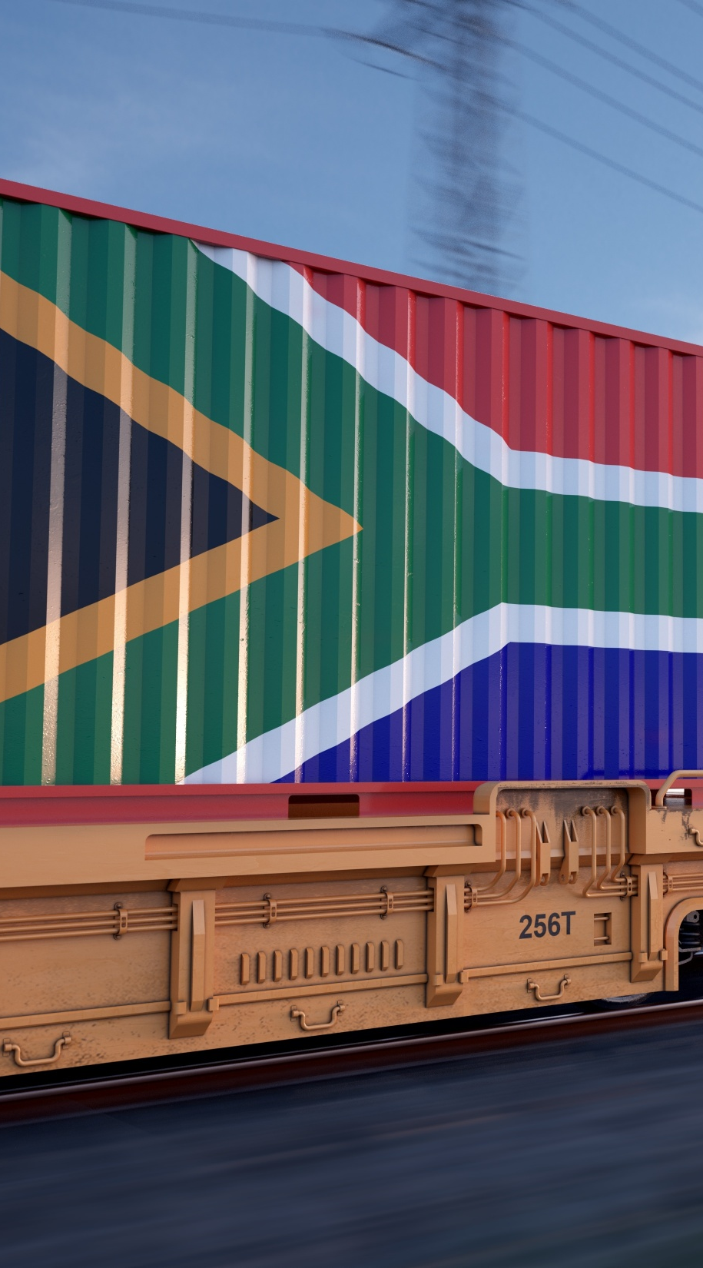
Annex:
Panel Q&A
Notes:
Panel Q&A and possible responses
Q: “Why aren’t pensions already investing heavily in transport?” A: “It’s usually not a willingness problem — it’s bankability, governance, concentration limits, liquidity, and credit quality. Credit enhancement and pooled vehicles can translate projects into pension-suitable instruments.”
Q: “Aren’t guarantees just hidden public debt?” A: “Good guarantees are targeted, transparently priced, and linked to performance; they can reduce total financing costs by bringing in new investors and longer tenors — and they can be paired with reforms.”
Q: “What is the practical next step after this conference?” A: “Agree on a priority pipeline and run structured market sounding with banks and institutional investors to calibrate tenor, coverage, triggers, and currency — exactly the kind of non-transactional technical engagement already being scoped with National Treasury and others.”
Q: “How can multilateral financial institutions help?” A: “By helping with policy and upstream reforms that create bankable projects, helping structure and mobilize finance, and providing risk cover that broadens the investor base and lowers the cost of capital.”

