Slide 1

Welcome to the
16 – 18 MARCH
2026
GALLAGHER CONVENTION
CENTRE, MIDRAND

Slide 2

Sparking Economic Growth in South Africa
Jacques Morisset
World Bank, March 2026

Slide 3
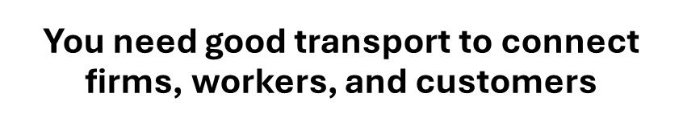
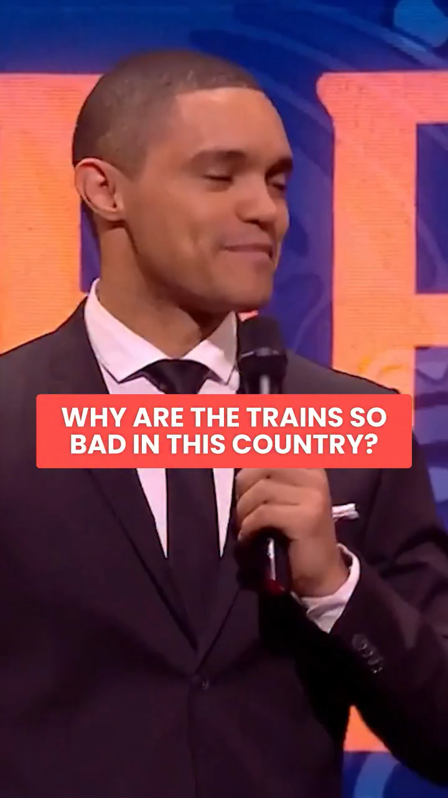
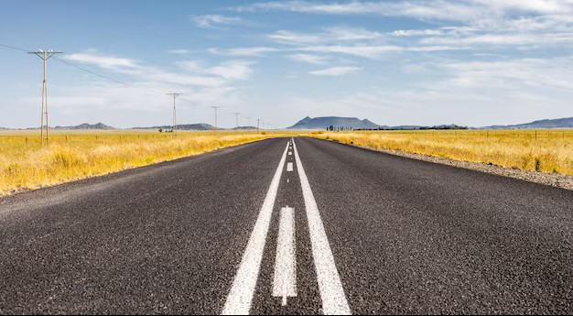
Economic Success in About Synergies
You need dynamic firms and people to avoid the syndrome of the empty road

Slide 4
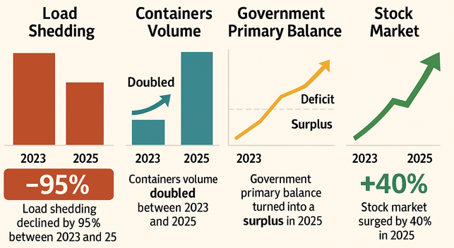
South Africa Shows Signs of Improvements

Slide 5
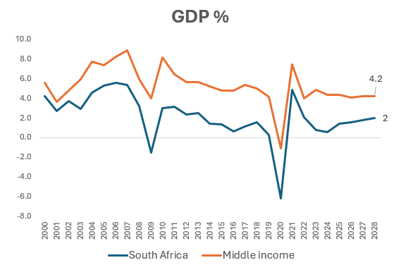
But Challenges Remain in the Real Economy
Economic growth lags other middle-income economies
Second highest unemployment rate in the world
Source: WDI and Global economic prospects

Slide 6
What’s still missing?
South Africa has the budget to eliminate extreme poverty
About 15,000 km of new transmission required until 2034, when Eskom only built 200 km per year in the last few years
Improve public spending efficiency
Improve coordination between departments, expand private partnerships, and incentivize subnational governments.
Deliver more and affordable infrastructure services
Improve grid access for renewable projects, open railways to multiple operators, and strengthen regulatory capacity.
Make cities an engine of inclusive growth
Reduce transport costs for poor commuters with e-vouchers and enhance urban densification in strategic locations.
Inject dynamism into the private sector
Reduce entry barriers for investors and improve access to financing for startups and small firms.
A low-income urban worker spends half of his earning on transport in South Africa against only 10% in Vietnam
The net entry of new firms is 1/3 slower than in other upper middle-income countries
Source: World Bank, 2024, Driving Inclusive Growth in South Africa.
Notes:
This is based on our 2024 study, Driving Inclusive in South Africa.
Joint collaboration with the government and local as well as international experts, including Nobel Laureate Micheal Spence.
Diagnostic but also recommendations with FIT (Feasible-Implementable-Timely actions.

Slide 7

Heat Map Progress Since 2024
Priorities | Progress
Dynamic private sector
Modern Infrastructure
Spatial agglomeration
Efficient state

Slide 8
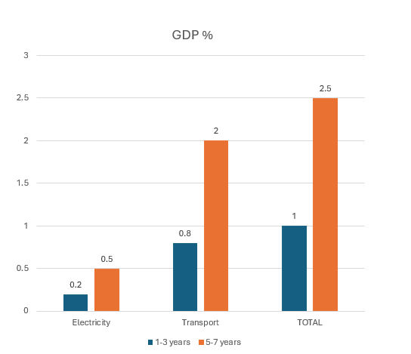
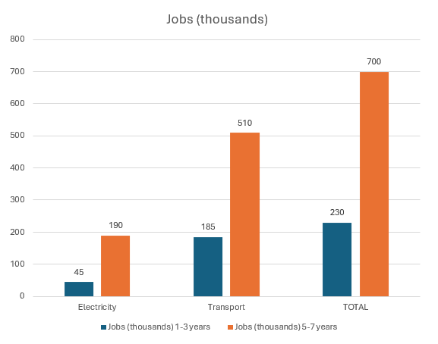
But the Impact of Infrastructure Reforms is Delayed In time
It will take 5-7 years for the economy to expand 2.5% faster and create about 700,000 new jobs
Source: World Bank

Slide 9
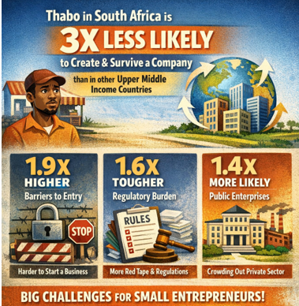
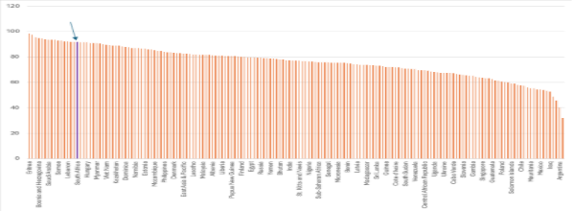
A Short-Term Stimulus Requires a Dynamic Private Sector
But the Regulatory Burden on Businesses is one of the Highest in the World
90% of firms consider labor regulation as a constraint
Source: Adapted from World Bank enterprises surveys

Slide 10
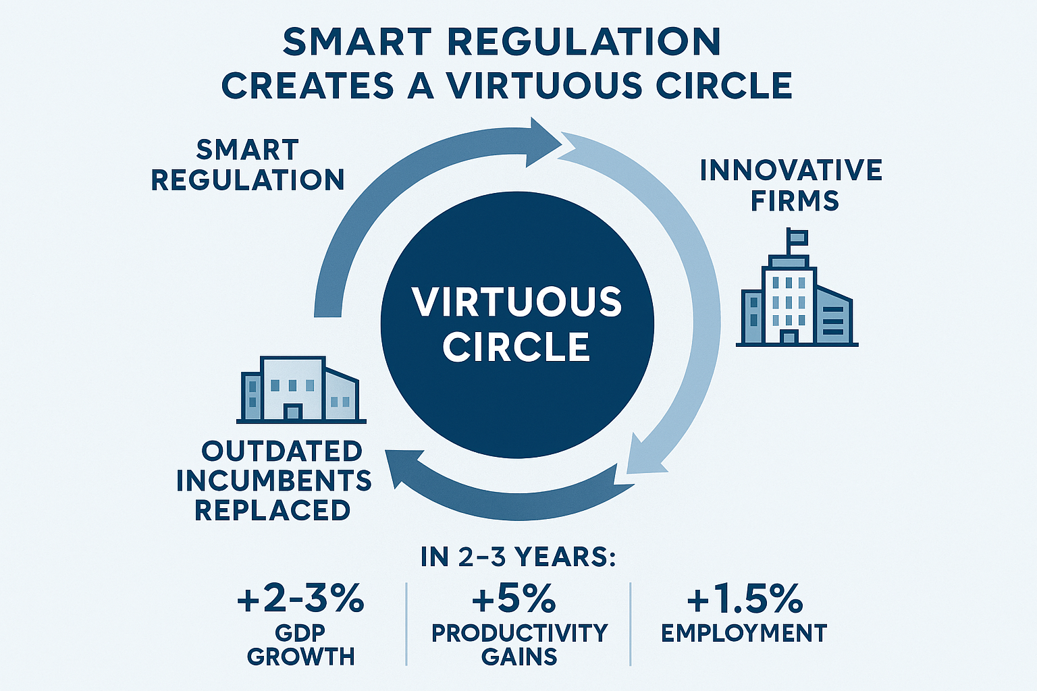
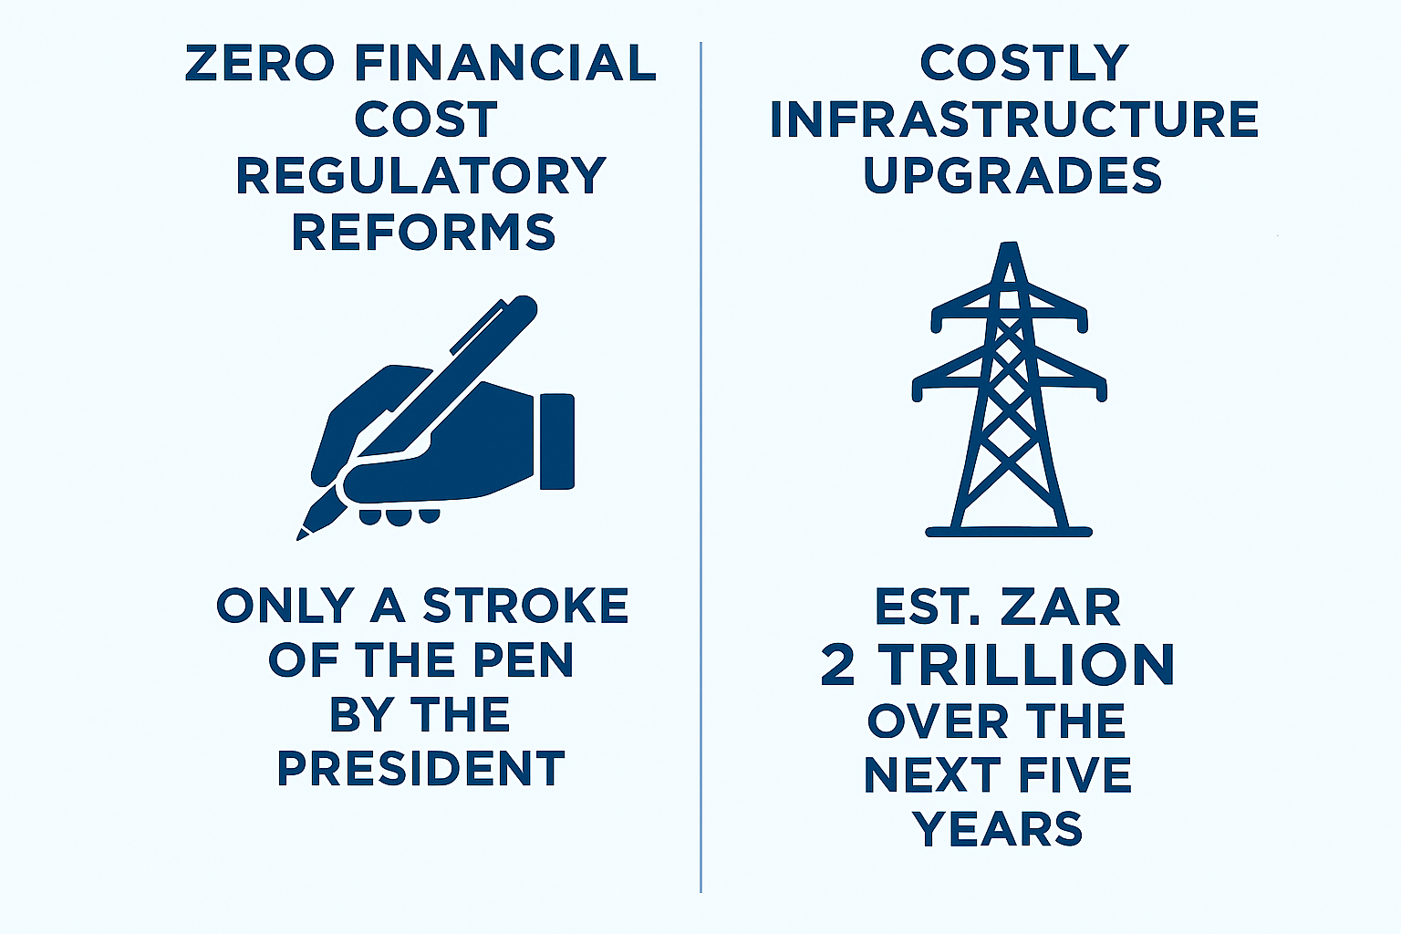
Lowering the Burden of Regulation is Effective and Cheap
Source: World Bank, 2024.

Slide 11
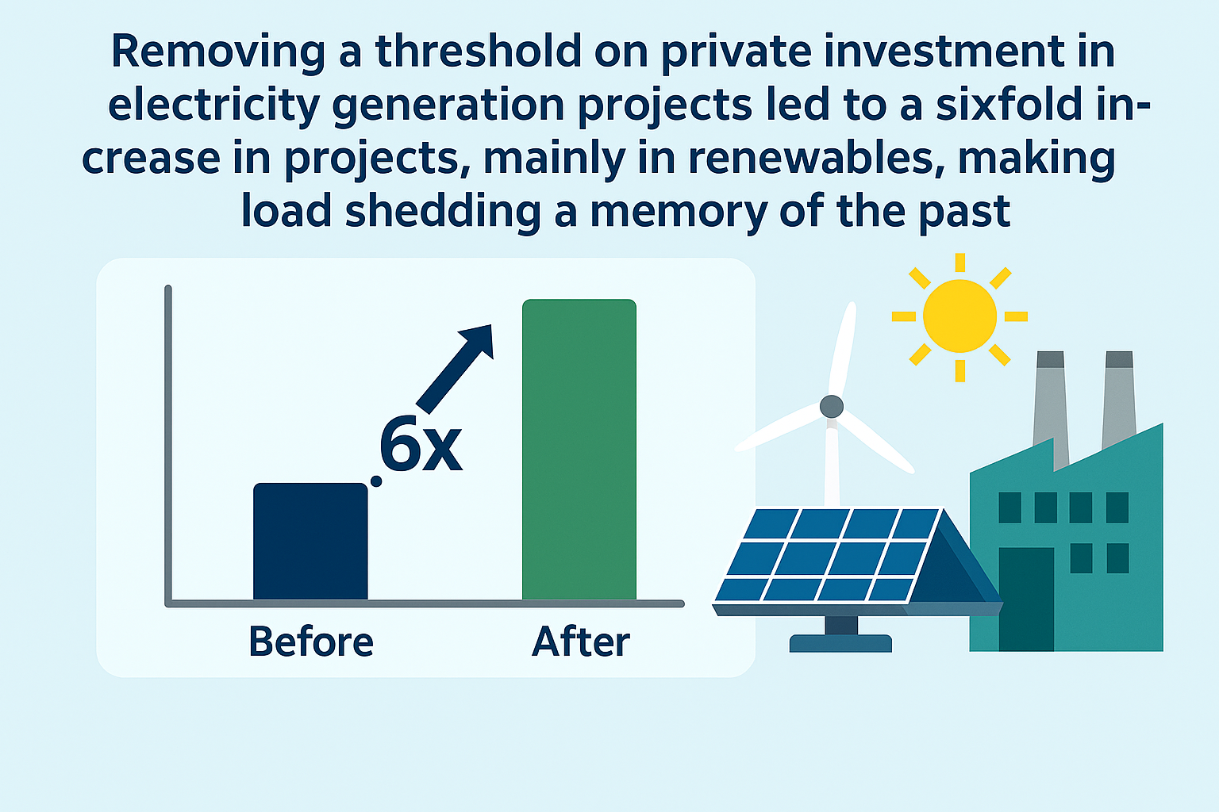
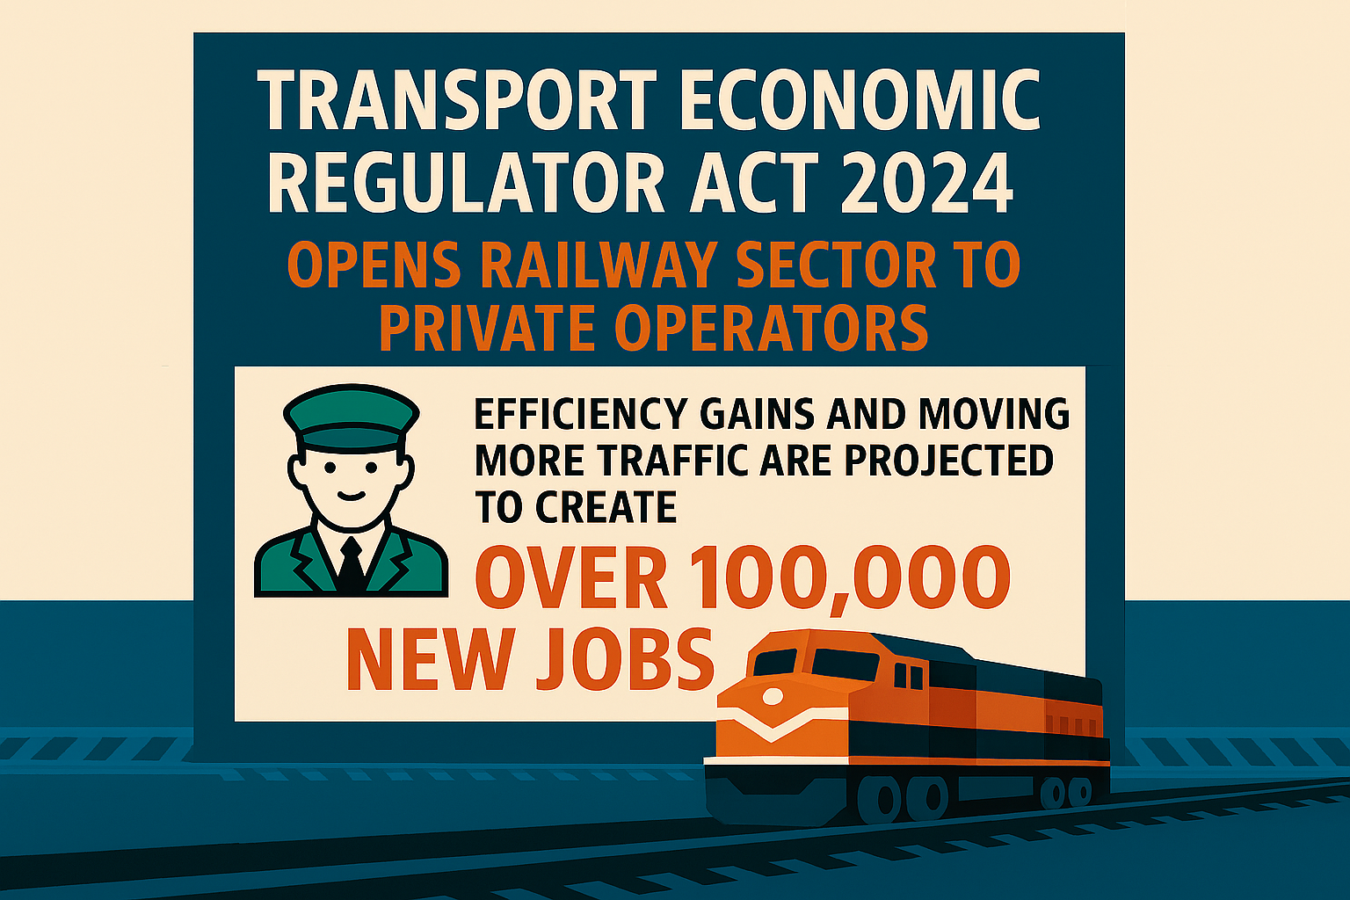
As Demonstrated by Two Recent Reforms in Infrastructure
Electricity
Freight Transport

Slide 12
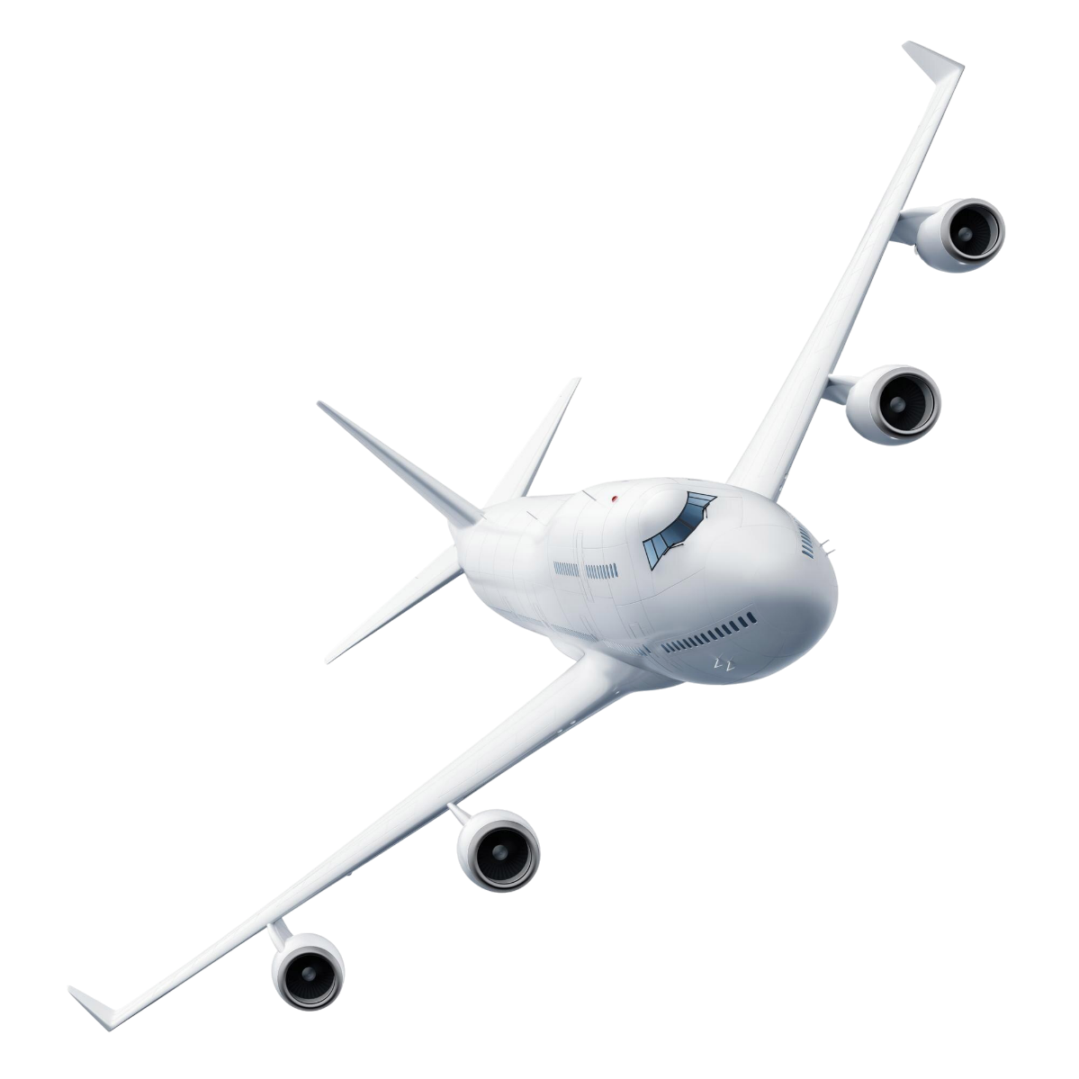
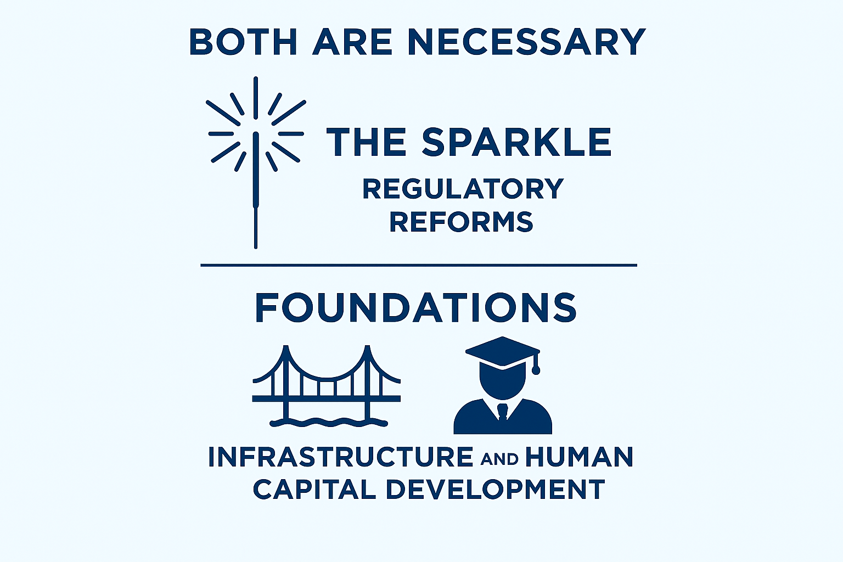
Economic Success is About Synergies
Achieving 3-5% GDP growth and Creating Jobs At Scale

Slide 13
Thank you

