Slide 1

Welcome to the
16 – 18 MARCH
2026
GALLAGHER CONVENTION
CENTRE, MIDRAND

Slide 2

World Bank Group - Credit Enhancements for South Africa’s Freight Logistics Sector
De-risking and Mobilizing Private Capital with Credit Enhancement and Risk Mitigation Products
Satheesh Sundararajan
Practice Manager
World Bank Group - Guarantee Platform

Slide 3

Addressing Large Infrastructure Financing Needs
Need for greater role of private capital
Large investment needs (ZAR 127 Billion) over 2025-2030.
Need to diversify the funding sources, optimize public finance to leverage private capital at scale. A spectrum of private sector participation, market-based and blended finance mechanisms need to be explored.
Mobilize different sources of private capital – equity investors, commercial banks and capital markets, institutional investors – domestic and international sources.
International and South African experience (e.g., REIPP Program) indicates that private participation should follow — not precede — offtaker creditworthiness, debt restructuring and institutional reforms.
Using MDB/DFI instruments, such as WBG risk mitigation and credit enhancements, strategically to de-risk and mobilize private capital.

Slide 4
WBG Guarantee Platform
Mobilizing Commercial Financing for Transnet and National Ports Authority

Slide 5
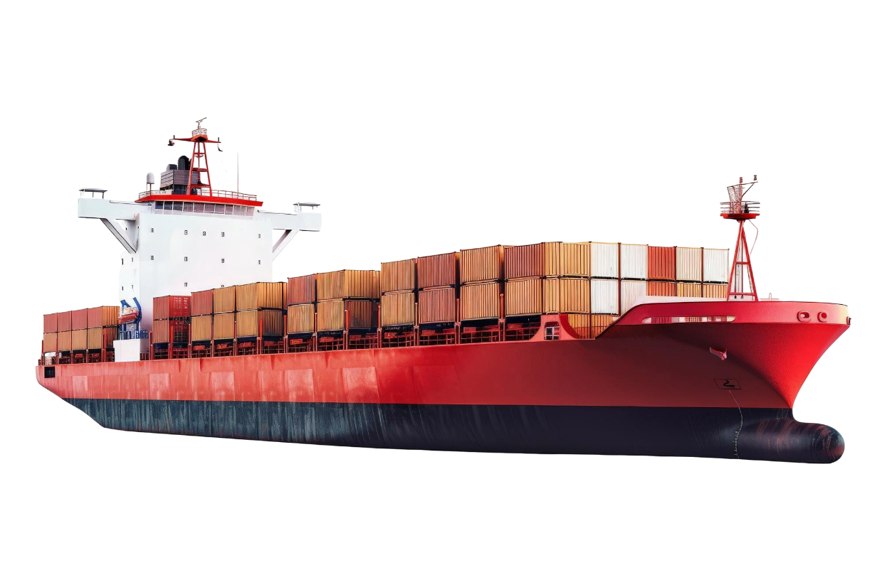
CASCADE Approach
Private sector investment can be facilitated through guarantees
Commercial funding
De-risking instruments and credit enhancements
Sequencing of funding
Blended and concessional finance
Public finance
Commercial funding
Public funding

Slide 6




Role of Guarantees – Supporting EMDE Governments
Several benefits of guarantees for governments seeking to fund major projects with limited public resources
Share risk and reduce financial burden
Raise additional financing by leveraging public/MDB resources
Reduce costs of borrowing, extend tenors and widen investor base
Enable demonstration effects
Notes:
Share financial risks associated with large-scale development projects with private investors and MDBs
Encourage FDI into EMDEs by protecting foreign investors against specific risks, enabling projects to proceed without additional public debt
Access commercial financing at better terms (longer tenors/lower interest rates), enhancing sovereign credit rating
Spark a virtuous cycle of private sector investment in the country as projects are successfully implemented and funders gain confidence and local experience

Slide 7
Different Applications of Guarantees – Supporting EMDE Governments
De-risking and Mobilizing Private Investments and Commercial Finance
PPPs and Private Projects
Public/SOE investments – Debt Financing
Development Banks - DFIs
Asset Monetization & Recycling
Risk Sharing Facilities – Financial Intermediaries
Payment default in PPPs and Concession - SPV, Equity, Debt
Gov. Performance, Political (BoC, WCD, TR, Expro.)
Mitigating Offtaker Creditworthiness
For public investments and/or debt optimization
Comprehensive but partial coverage.
Mitigating debt service default of public borrowers
For on-lending a portfolio of public and private investments
Comprehensive but partial coverage on a portfolio basis
For innovative brownfield concessions to unlock asset value
Securitizing future revenues to raise upfront capital – tariff and/or demand - regulatory risk
For transport decarbonization investments (E-mobility, GH
MSME/SME–small scale projects
Portfolio approach to meet payment shortfalls

Slide 8

WBG Guarantee Platform – Supporting EMDE Governments
WBG Guarantee platform provides governments with the expertise and support they need to unlock private sector investment
Governments and other public entities
Access to experts and product offerings across institutions
Leverage combined balance sheet of World Bank Group
Notes:
The World Bank Group Guarantees platform has been designed to provide our clients easy and full access to all institutions across the World Bank Group
In particular, there are three tangible benefits for governments and public entities:
Local support and expertise with representatives of the Guarantees platform across geographies
Access to the World Bank Groups full guarantee product menu to support specific needs and context, and best give the private sector confidence to invest in EMDEs
Streamlined underwriting process which enable faster and simpler guarantee approvals
Share financial risks associated with large-scale development projects with private investors and MDBs
Encourage FDI into EMDEs by protecting foreign investors against specific risks, enabling projects to proceed without additional public debt
Access commercial financing at better terms (longer tenors/lower interest rates), enhancing sovereign credit rating
Spark a virtuous cycle of private sector investment in the country as projects are successfully implemented and funders gain confidence and local experience

Slide 9
Credit Enhancement and Risk Mitigation Products
When to use and get the best benefits for Public and Private Sector
When to use ?
Not a standalone instrument, as part of a broader reform implementation, raises private capital to complement public capital
Public Sector/SOEs to access commercial financing for priority public sector projects or corporate debt restructuring of SOEs
Usually accompanying reforms or government commitments to help the public sector borrower enhance credit worthiness
Improve bankability and maximize competition from private investors through de-risking investments in PPPs
Diversify financing sources from domestic and international long-term institutional investors, lenders and equity investors
MDB Guarantees, such as WBG Guarantees, are ‘AAA’– enable commercial banks to receive capital relief (0% risk weighting)
Some MDB products (e.g., IBRD Guarantee) require sovereign counter guarantee/Indemnity, but are concessionally priced
Quantitative value – leverage public/MDB capital; reduce financing cost, extend loan tenor, attract new financiers
Qualitative value – different applications, project preparation, due diligence. greater credibility, contractual discipline

Slide 10
Satheesh Sundararajan
Practice Manager
IBRD/IDA Guarantees – MIGIG (DC)
ssundararajan@worldbank.org
Thank you

