Slide 1
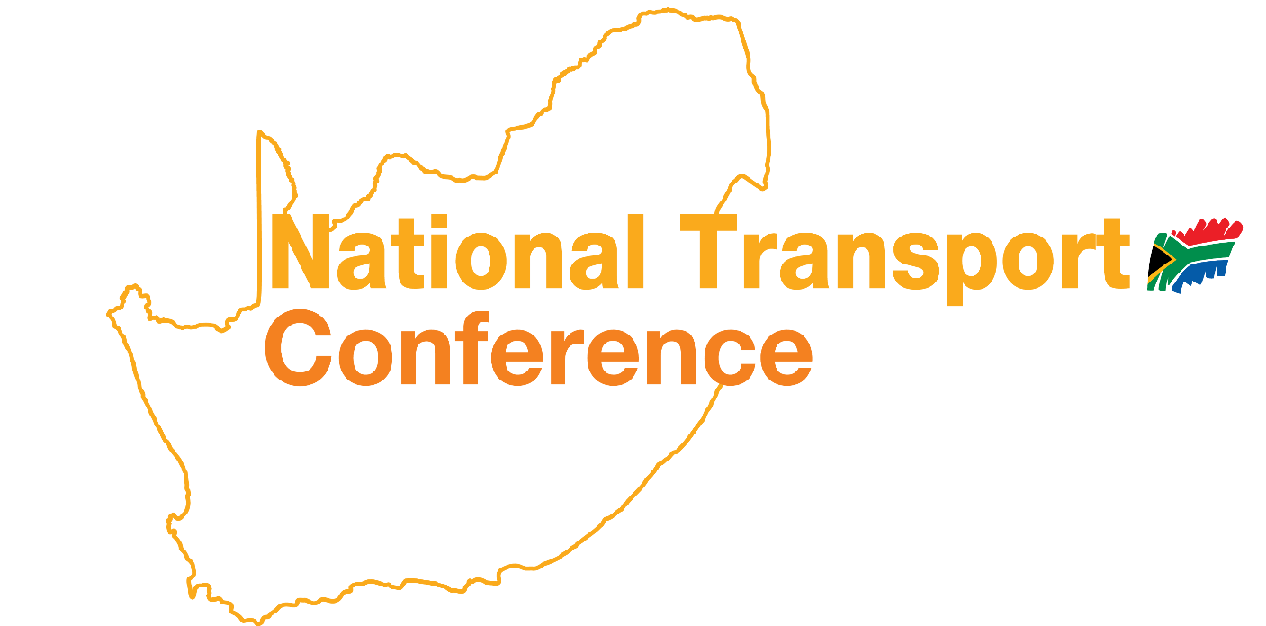
Welcome to the
16 – 18 MARCH
2026
GALLAGHER CONVENTION
CENTRE, MIDRAND

Slide 2
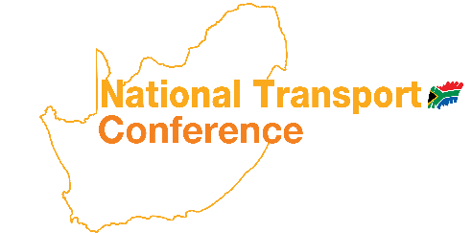
Mary Chirwa
Candidate Researcher
CSIR Smart
The Effective Championing of Drones in South Africa
Notes:
Good afternoon everyone.
Today I want us to think about drones not just as flying gadgets, but as infrastructure tools that can transform how we deliver services, inspect infrastructure, and support research in South Africa.
In the next few minutes, I will briefly explain what an unmanned aircraft system is,
paint a picture of what a drone-enabled South Africa could look like,
reflect on our country’s pioneering role in this field,
and highlight the key challenges we need to solve for drones to truly thrive.

Slide 3
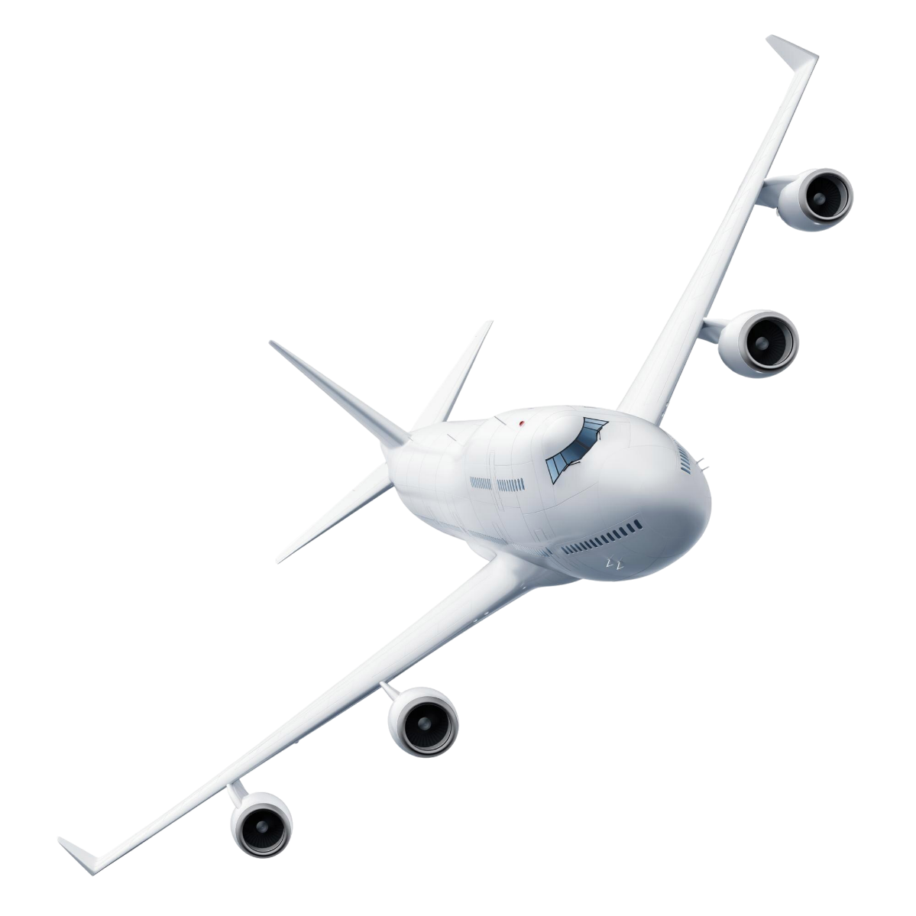
What is an Unmanned Aircraft System (UAS)?
An Unmanned Aircraft System consists of:
The unmanned aircraft (drone)
Ground control station
Communication links
Navigation systems
Sensors and payload
Unlike traditional aircraft, the pilot is not onboard.
Notes:
When we talk about drones, technically we are referring to Unmanned Aircraft Systems, or UAS.
A UAS is not just the aircraft itself. It includes the drone, the ground control station where the operator pilots the aircraft, the communication link that connects the aircraft and the operator, and the sensors or payload that collect information.
The key distinction from traditional aviation is that the pilot is not onboard the aircraft. The aircraft is either remotely piloted or can operate autonomously through onboard systems.
This distinction changes how aviation can be used across many sectors

Slide 4
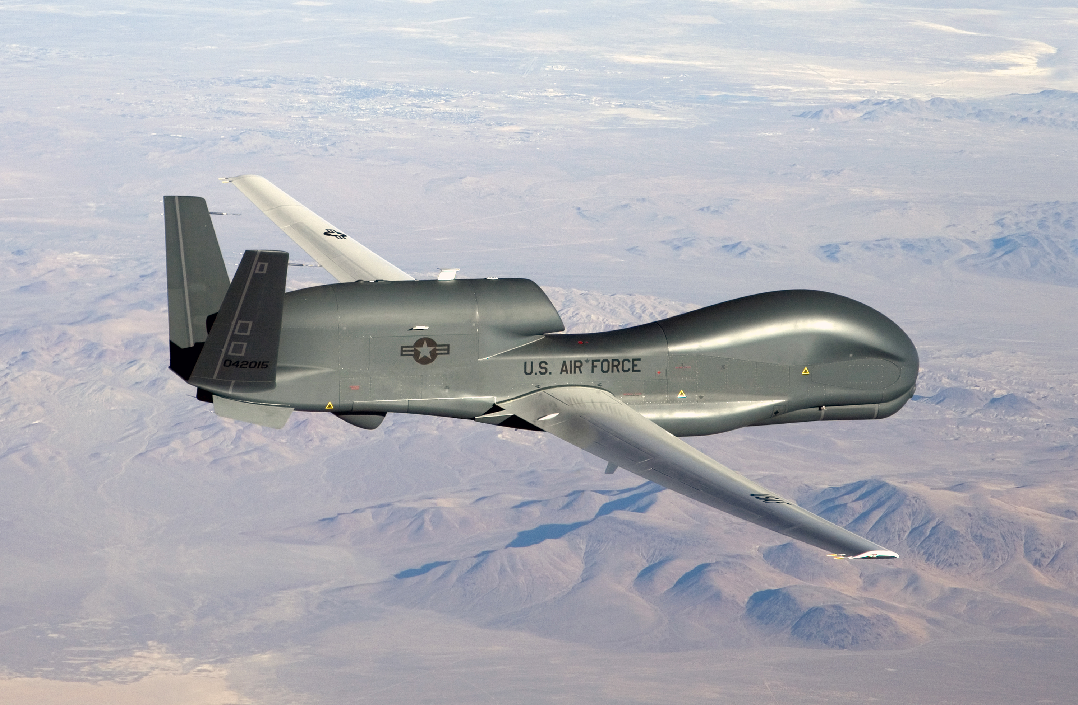
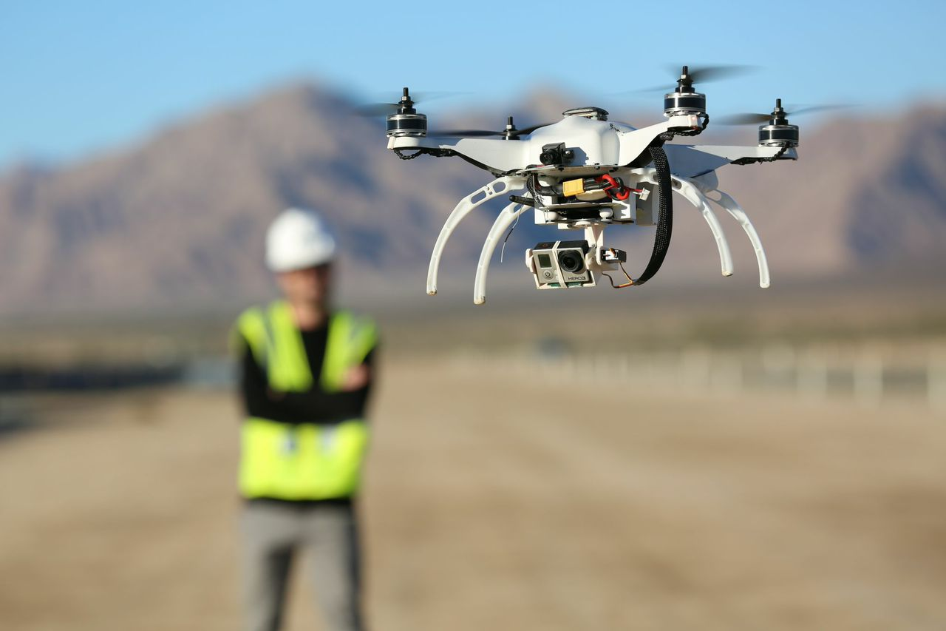
Manned vs Unmanned Aviation
Manned Aviation | Unmanned Aviation
Pilot onboard aircraft | Pilot remote or autonomous
Higher operational risk | Reduced human risk
Shorter endurance | Potential for longer endurance
Higher operational cost | Lower operational cost
This Photo by Unknown Author is licensed under CC BY-SA
This Photo by Unknown Author is licensed under CC BY-NC
Notes:
Unmanned aviation fundamentally changes the economics and risk profile of flight operations.
In traditional aviation the pilot must always be onboard the aircraft, which limits endurance, increases cost, and introduces risk to human life.
With unmanned aviation, the aircraft can be remotely piloted or automated.
This reduces risk to human operators and allows aircraft to perform missions that might otherwise be too dangerous, too expensive, or simply impractical.
Because of this, drones open opportunities across many industries.

Slide 5
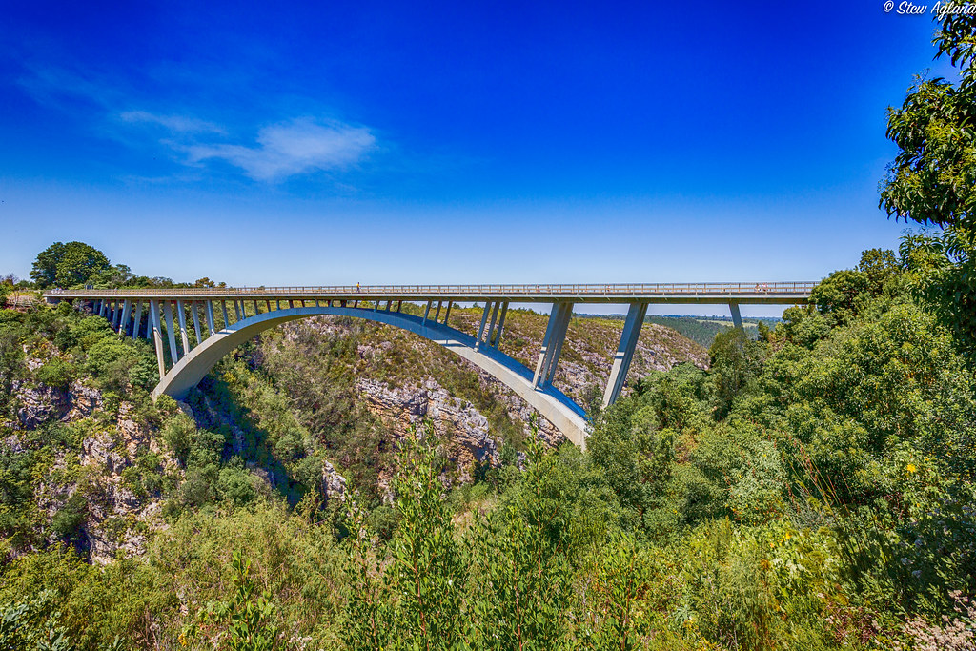
Imagine a South Africa Where Drones Thrive
Gog’ Khumalo receives chronic medication delivered by drone in rural Limpopo
Naledi completes environmental research using long-range drone surveys
Infrastructure inspections are conducted faster and safer
Emergency responders assess disaster areas in minutes
Themba proposes to his girlfriend during a coordinated drone light show
Amy’s baby takes an air-taxi scholar transport to school
Notes:
Let us imagine for a moment what a drone-enabled South Africa could look like.
Imagine Gog’ Khumalo in rural Limpopo receiving her chronic medication delivered by drone instead of travelling long distances to a clinic.
Imagine Naledi, a postgraduate researcher, using long-range drones to conduct environmental monitoring and research.
Drones can also significantly change how we inspect infrastructure.
Take the Paul Sauer Bridge on the N2, for example. The bridge sits approximately 120 metres above the Storms River gorge, which makes inspections extremely challenging. Engineers and inspectors must work at significant heights, often in strong winds coming through the gorge, with limited access to structural components.
Traditionally engineers rely on Under-Bridge Inspection Units, or UBIUs, to access the underside of bridges. On bridges with large elevations like this, these units must extend far over the gorge while operating from the bridge deck.
Wind conditions and access constraints can make these inspections complex and risky, and they often require lane closures and significant safety management.
Using drones allows engineers to capture high-resolution imagery and structural data from difficult locations while reducing risk to inspectors and minimizing disruption to traffic.
Emergency responders could also use drones to map disaster areas minutes after floods or fires.
Even social experiences could change — imagine Themba proposing to his girlfriend during a coordinated drone light show.
And looking slightly further ahead, imagine Amy’s baby taking an air-taxi scholar transport to school, using advanced air mobility systems operating safely within urban airspace.
Many of these applications are already being explored around the world.

Slide 6
South Africa’s Pioneering Role
South Africa has been an early leader in UAV development:
1977: CSIR develops the Champion UAV
1980s: SAAF deploys UAVs for reconnaissance
Development of the Seeker UAV series
South Africa among the first countries to introduce drone regulations in 2015
Notes:
South Africa actually has a long history in unmanned aviation.
In the late 1970s, the CSIR developed the Champion UAV, which was one of the early examples of unmanned aircraft research in the country.
During the 1980s, the South African Air Force deployed UAV systems operationally for reconnaissance missions, which eventually led to the development of the Seeker UAV series.
South Africa was also among the first countries globally to introduce formal regulations governing drone operations.
So in many ways, South Africa has been a pioneer in both UAV development and regulatory frameworks

Slide 7
South Africa’s Drone Opportunity
Transport
infrastructure inspections
traffic monitoring
Healthcare
medical deliveries
Agriculture
crop monitoring
disease detection
Environment
wildlife monitoring
anti-poaching
Emergency Response
disaster mapping
search and rescue
Urban Mobility
air-taxi scholar transport
urban air mobility
Notes:
The opportunity for drones in South Africa extends across multiple sectors.
In transport, drones can support infrastructure inspections, traffic monitoring, and asset management.
In healthcare, they can deliver medical supplies to remote communities where traditional logistics are difficult.
In agriculture, drones help farmers monitor crop health and detect disease earlier.
They can also assist with wildlife monitoring and anti-poaching efforts in conservation areas.
And looking further ahead, Advanced Air Mobility systems could introduce new forms of urban transportation, including air-taxi services and potentially even scholar transport solutions.
These technologies are already being explored internationally, and South Africa has the technical capability to participate in this transformation.

Slide 8
Challenges to a Thriving Drone Ecosystem
Key challenges include:
Regulatory complexity
Limited BVLOS operational capability
Airspace integration with manned aviation
Lack of supporting infrastructure such as vertiports
Fragmented pilot projects and initiatives
Notes:
Despite the enormous potential, several challenges still limit the growth of the drone ecosystem.
Regulatory frameworks must continue evolving alongside rapidly advancing technology.
Operations such as Beyond Visual Line of Sight, which are essential for logistics, infrastructure inspections, and large-scale monitoring, remain complex to implement.
Another challenge is airspace integration.
Unmanned aircraft must safely coexist with traditional aviation within shared airspace.
We also need to start thinking about supporting infrastructure such as vertiports, which will be necessary if urban air mobility becomes a reality.
Finally, many drone initiatives remain fragmented pilot projects rather than coordinated national programmes.
Addressing these issues requires collaboration between regulators, researchers, industry, and government.

Slide 9
Building the Drone Ecosystem
To unlock the full potential of drones:
Risk-based regulatory frameworks
Drone corridors and testing zones
Integration with air traffic management systems
Infrastructure planning including vertiports
Regulatory sandboxes to enable innovation
Notes:
To move from isolated pilot projects to a thriving drone ecosystem, we need to think more systematically about enabling conditions.
This includes risk-based regulatory frameworks that match regulatory oversight with operational risk.
It includes drone corridors and testing zones where new technologies can be safely developed.
Air traffic management systems must evolve to integrate unmanned aircraft operations.
Cities and transport planners will also need to begin considering supporting infrastructure such as vertiports.
And regulatory sandboxes can provide environments where innovators can test new concepts safely before scaling them nationally.

Slide 10
The Future of Drones in South Africa
South Africa already has:
technical expertise
aviation heritage
strong research institutions
The opportunity now is to:
build a coordinated drone ecosystem that enables innovation, safety and economic growth.
Notes:
South Africa already has many of the ingredients required to lead in this space.
We have strong aviation heritage, advanced research institutions, and growing technical capability.
The real opportunity now is to bring these elements together into a coordinated ecosystem that enables innovation while maintaining safety.
The question is not whether drones will transform industries.
The question is whether South Africa will position itself to lead that transformation.
Thank you.

Slide 11
Thank you
Email: Mchirwa@csir.co.za

