Slide 1

Welcome to the
16 – 18 MARCH
2026
GALLAGHER CONVENTION
CENTRE, MIDRAND

Slide 2

Shaping a Sustainable Future: ICAO’s Leadership on Global Aviation Environmental Reform
Mrs. Chinga Mazhetese
International Civil Aviation Organisation (ICAO)
Regional Officer: Environment/ Meteorology

Slide 3
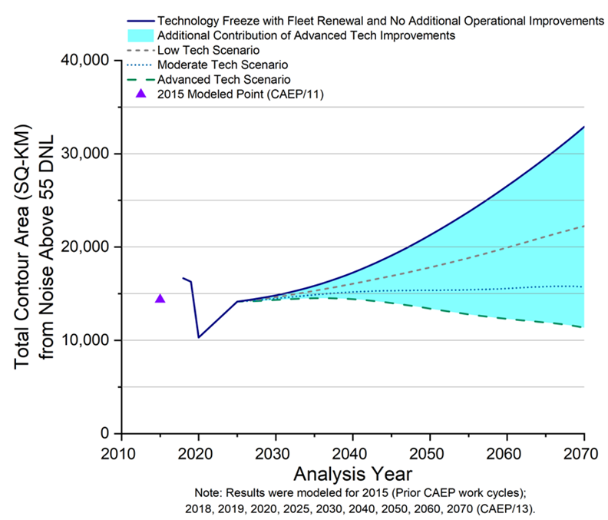
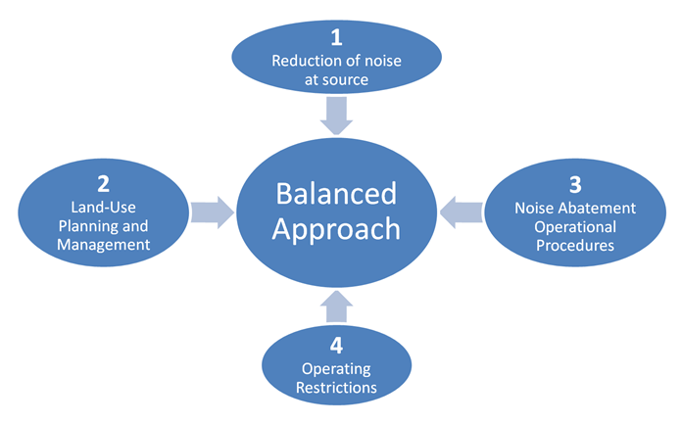
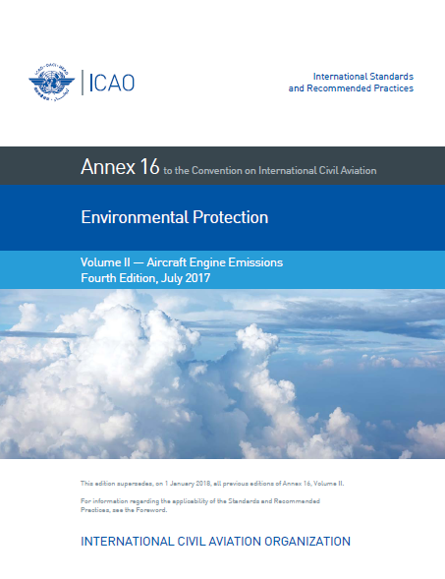
ICAO’s Leadership in Transforming Global Aviation Environmental Protection
Aircraft noise certification and noise management frameworks
1st Volume of ICAO Annex 16 to be developed.
SARPs for Noise first adopted by the ICAO Council in April 1971
The main overarching ICAO policy on aircraft noise is the Balanced Approach to Aircraft Noise Management, adopted by the ICAO Assembly in its 33rd Session (2001).

Slide 4
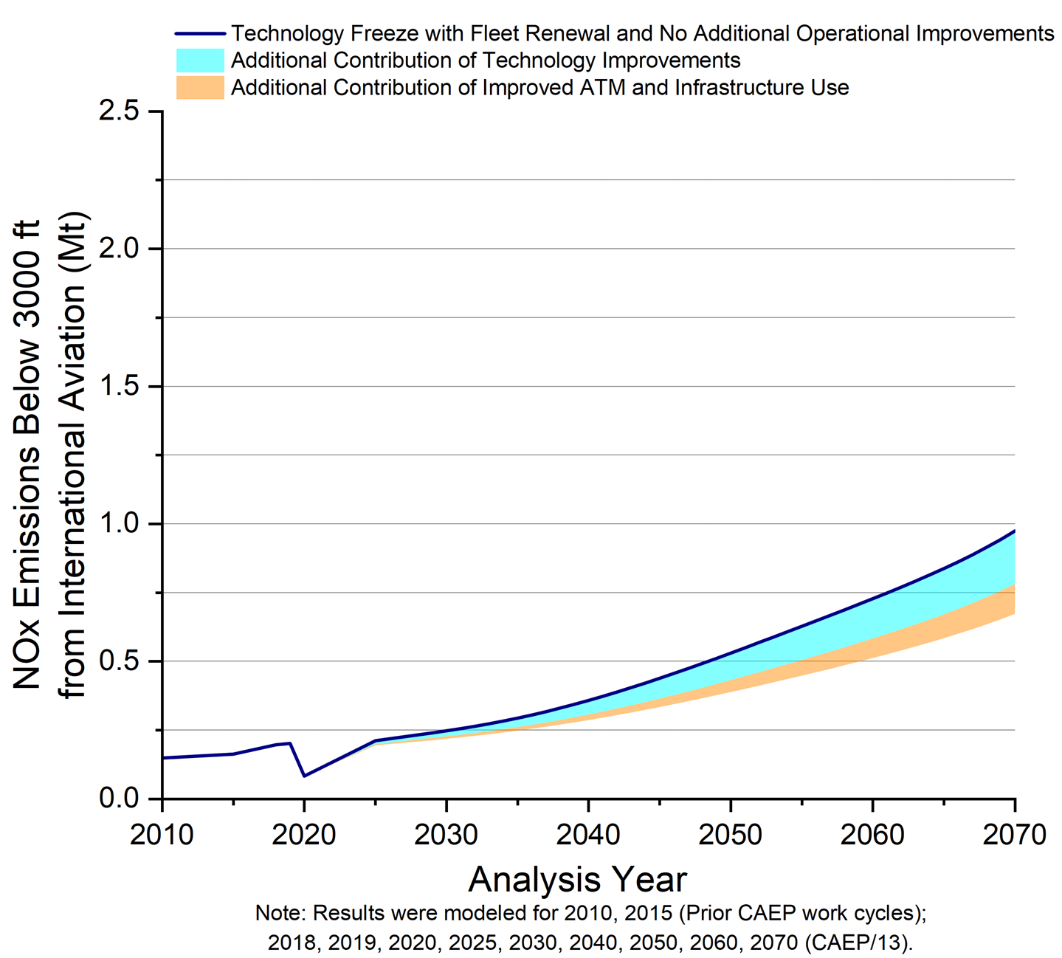
ICAO’s Leadership in Transforming Global Aviation Environmental Protection
Local Air Quality (LAQ)
2nd Volume of ICAO Annex 16 to be developed.
SARPs for Engine Emission adopted after the 2nd meeting of the ICAO Committee on Aircraft Engine Emissions.
ICAO provisions on LAQ also address:
liquid fuel venting;
non-volatile Particulate Matter (nvPM) impacts; and
the main gaseous exhaust emissions from jet engines- hydrocarbons (HC), oxides of nitrogen (NOx), carbon monoxide (CO).

Slide 5
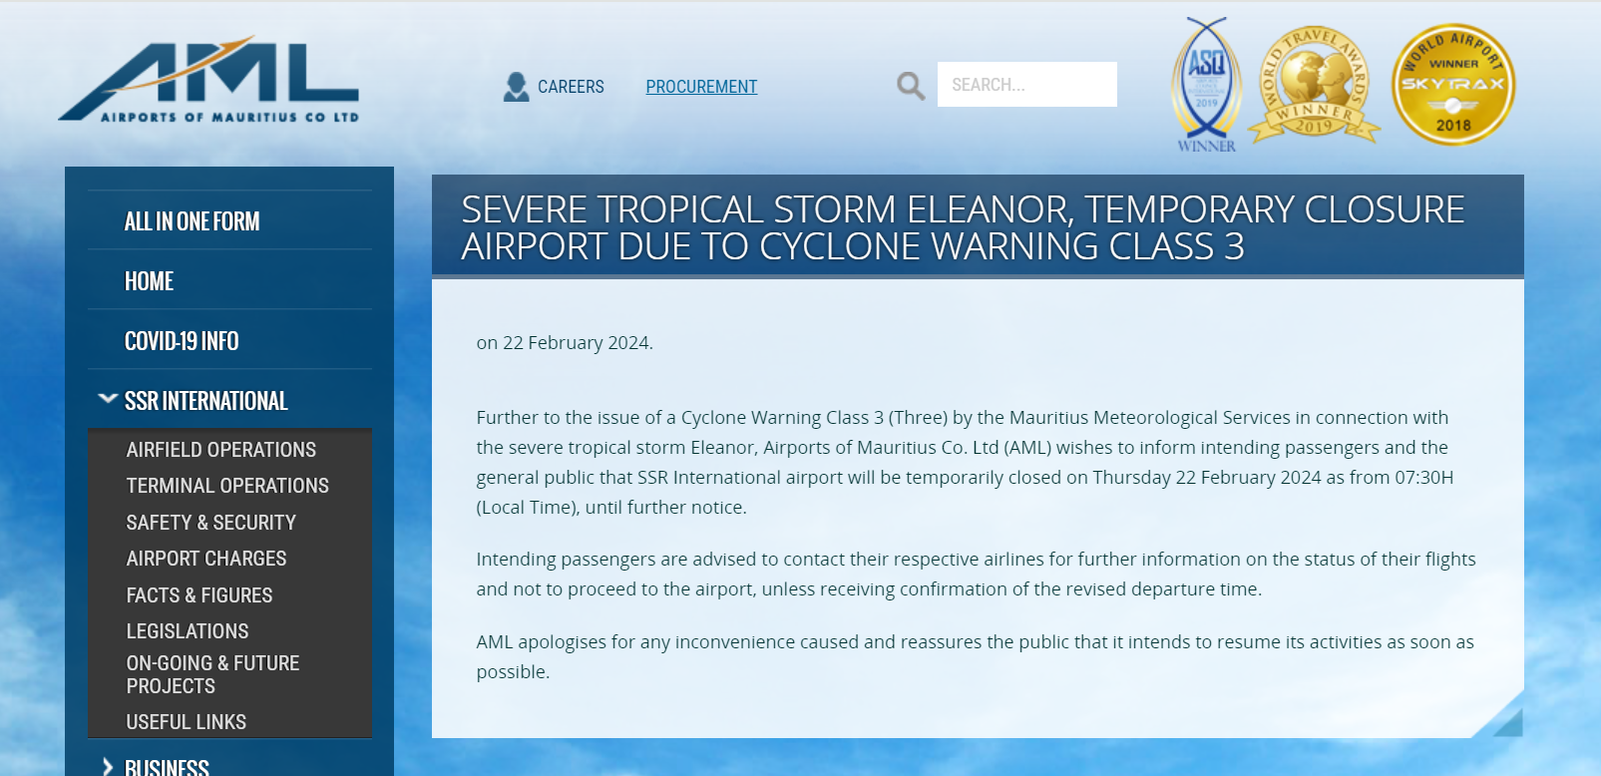
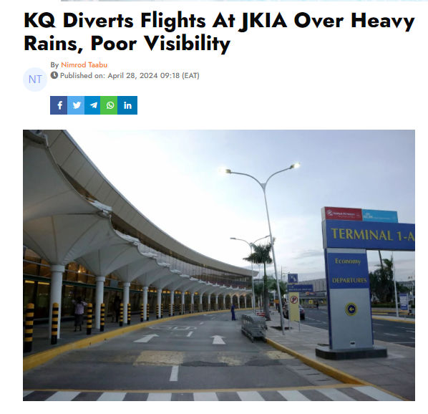
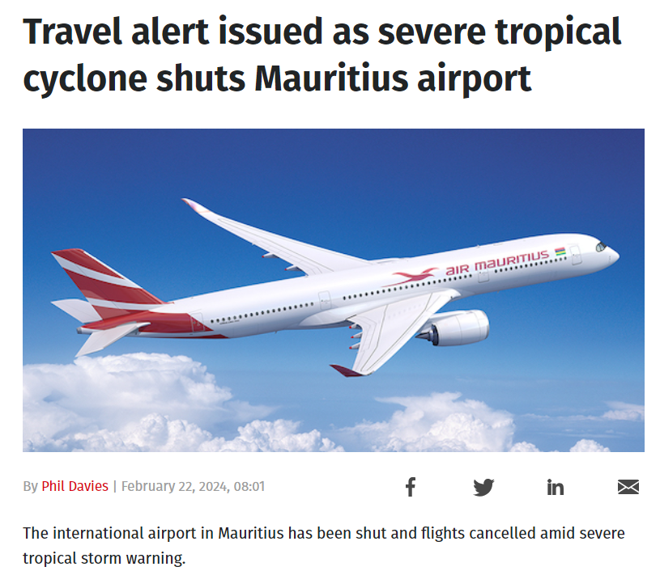
ICAO’s Leadership in Transforming Global Aviation Environmental Protection
Climate Change- Examples of weather events that affected aviation in the Region
Tropical Storm Eleanor- February 2024
Heavy rains leading to flooding- April 2024
https://www.citizen.digital/news/kq-diverts-flights-at-jkia-over-heavy-rains-poor-visibility-n341210
https://airportsofmauritius.aero/index.php/press/532-severe-tropical-storm-eleanor-temporary-closure-airport-due-to-cyclone-warning-class-3
https://travelweekly.co.uk/news/air/travel-alert-issued-as-severe-tropical-cyclone-shuts-mauritius-airport

Slide 6

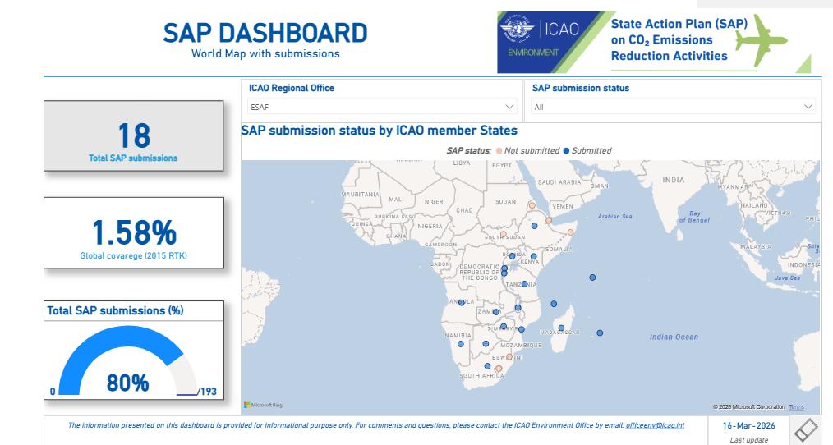
ICAO’s Leadership in Transforming Global Aviation Environmental Protection
Climate Change
State Action Plans (SAPs)
on reduction of CO₂ emissions from international aviation
Launched in 2010
Revised every 3 years

Slide 7
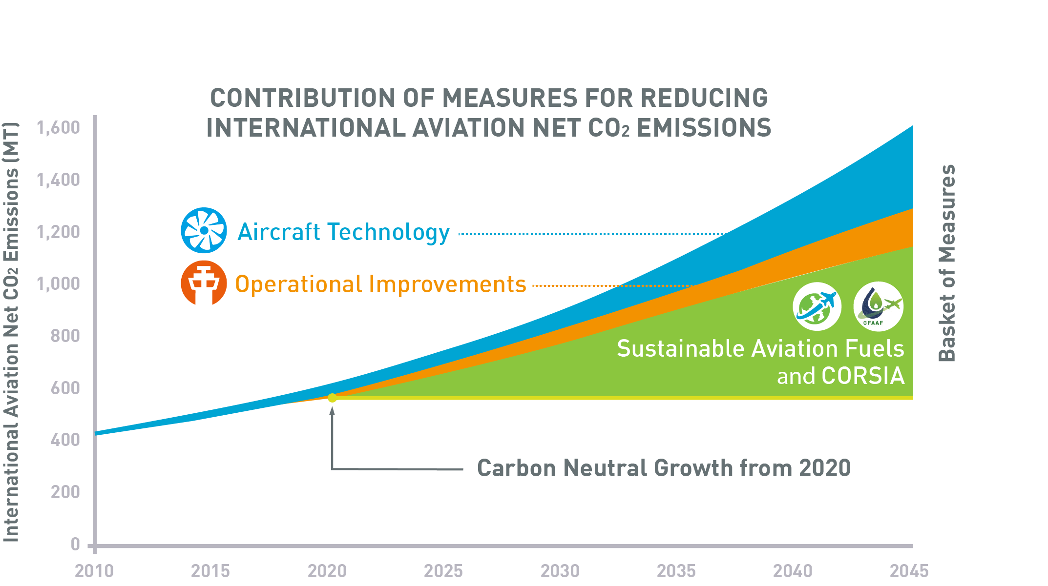
ICAO’s Leadership in Transforming Global Aviation Environmental Protection
Climate Change
GOAL on Carbon Neutral Growth 2020 (CNG2020)
Carbon Offsetting and Reduction Scheme for International Aviation (CORSIA)- for Aeroplane Operators
Up to 2035 (Annex 16 Vol IV) but subject to a special review in 2032.

Slide 8
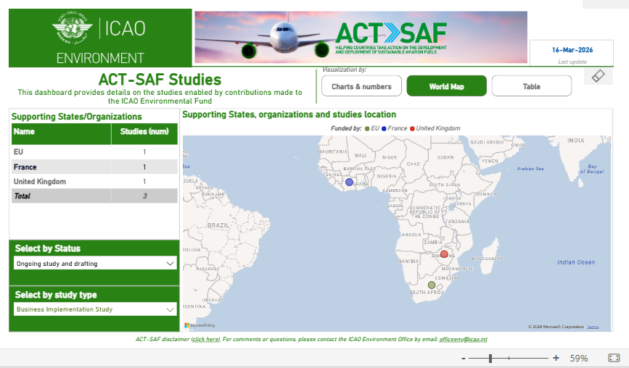
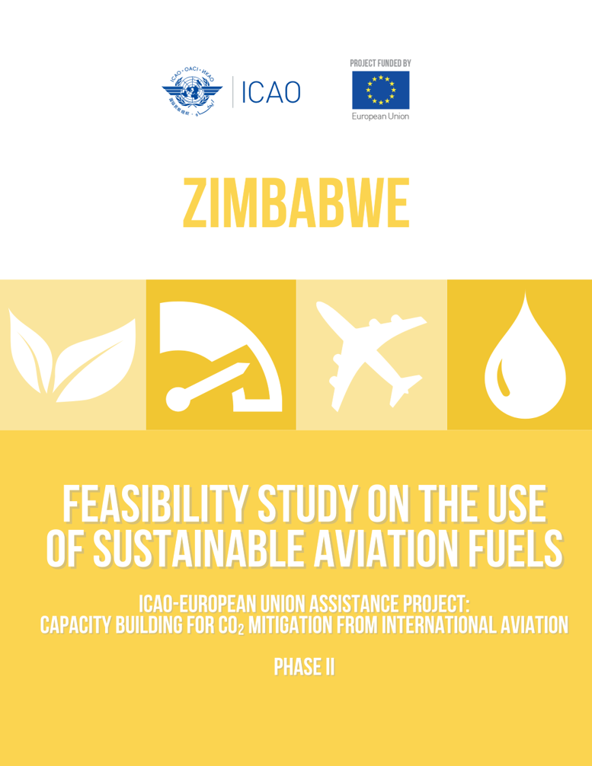
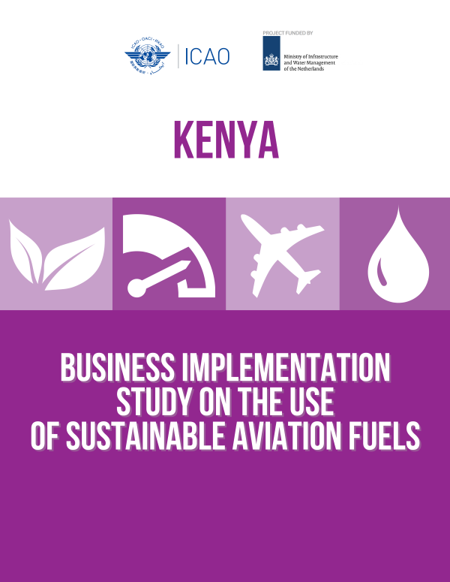
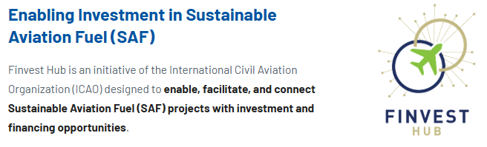
ICAO’s Leadership in Transforming Global Aviation Environmental Protection
Climate Change - The ICAO Assistance, Capacity-building and Training for Sustainable Aviation Fuels (ACT-SAF) Programme
The ICAO ACT-SAF Programme creates opportunities for States to develop their full potential in SAF development and deployment.

Slide 9
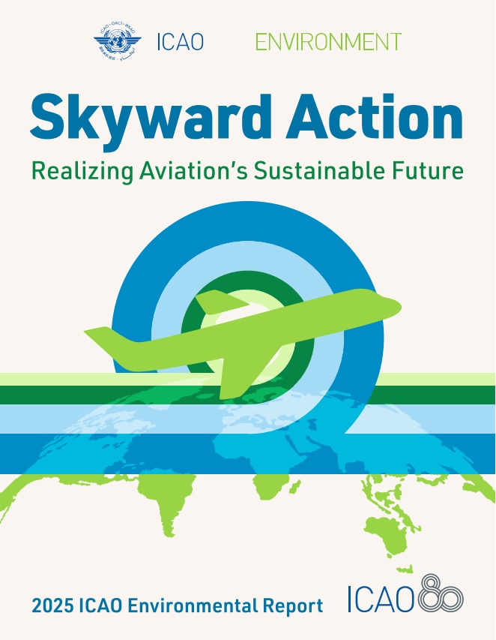


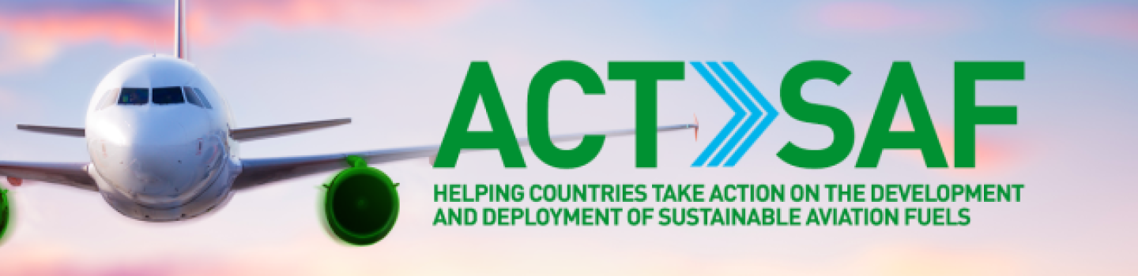


Conclusion
ICAO remains committed to supporting the global transition toward net‑zero carbon emissions from international aviation by 2050:
through the continued strengthening of internationally agreed environmental standards and enhanced cooperation among all States.
The active engagement of Member States, industry stakeholders, and international partners
essential to advancing policies that promote sustainable aviation fuels (SAF), improve operational efficiency and promote the development and deployment of cleaner and more innovative technologies.
ARE THE MEMBER STATES READY?
Information and additional resources on ICAO’s environmental programmes, the LTAG framework and SAF initiatives are available at https://www.icao.int/environmental-protection

Slide 10
Thank you

